Slide 1





Reconstructing life histories of white sharks using vertebral chemistry
John A. Mohan^{1,2}, Nathan R. Miller³, Sharon. S. Herzka⁴, Oscar Sosa-Nishizaki⁴, Emiliano García-Rodríguez⁴, Alfonsina Romo-Curiel⁴, R.J. David Wells²
1
3
Funding:
4
2

Slide 2
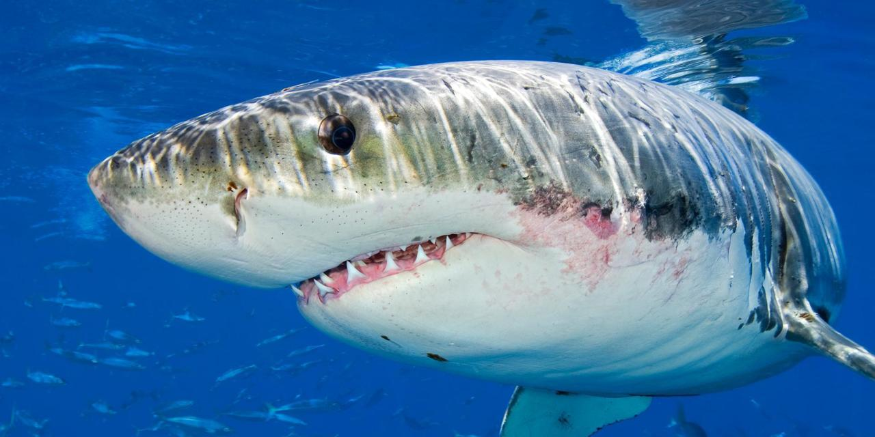
White sharks (Carcharodon carcharias)
http://www.bbc.com/earth/story/20151005-the-truth-about-great-white-sharks
Notes:
White sharks – one of the most popular shark species and well known by the general public
Many people fascinated by the species, others afraid as attacks on humans do occur
Bleong to the lamnid family of sharks -
As a highly migratory species, understanding movement patterns

Slide 3
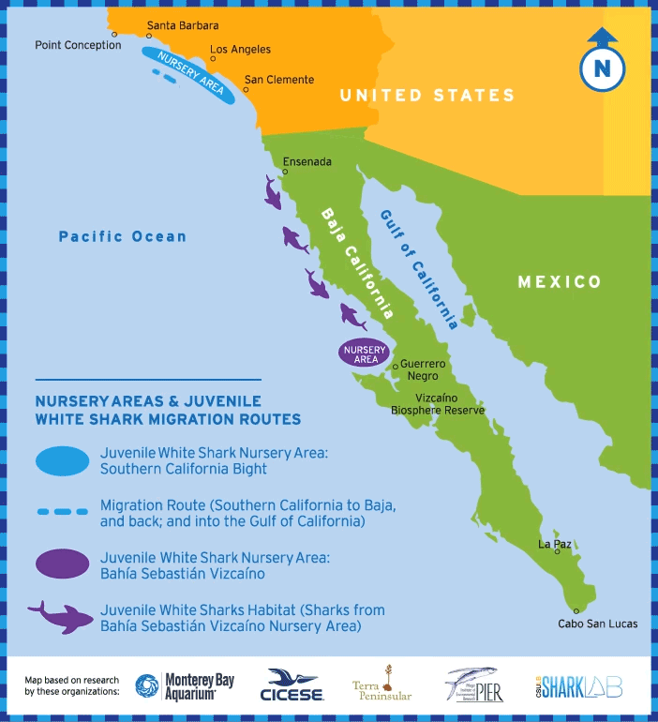
White shark ecology
Juvenile movements
Nursery habitats in Pacific Ocean
Biotelemetry
Notes:
Current understanding of Pacific

Slide 4
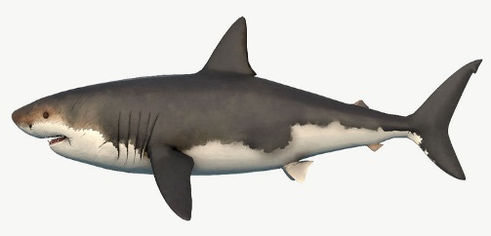
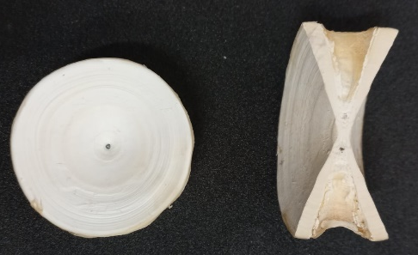
Vertebrae chemistry
Cordy, Free3D

Slide 5
Vertebrae chemistry
Cordy, Free3D
Mohan et al. (2018)

Slide 6
Research questions
How does vertebrae chemistry vary across ontogeny?
  Maternal consistency among individuals and elements
Does vertebrae edge chemistry reflect spatial environmental gradients?
  Pre-capture comparison (Pacific vs Gulf of California)
Notes:
If you took individual vert, how much does element vary/.’

Slide 7
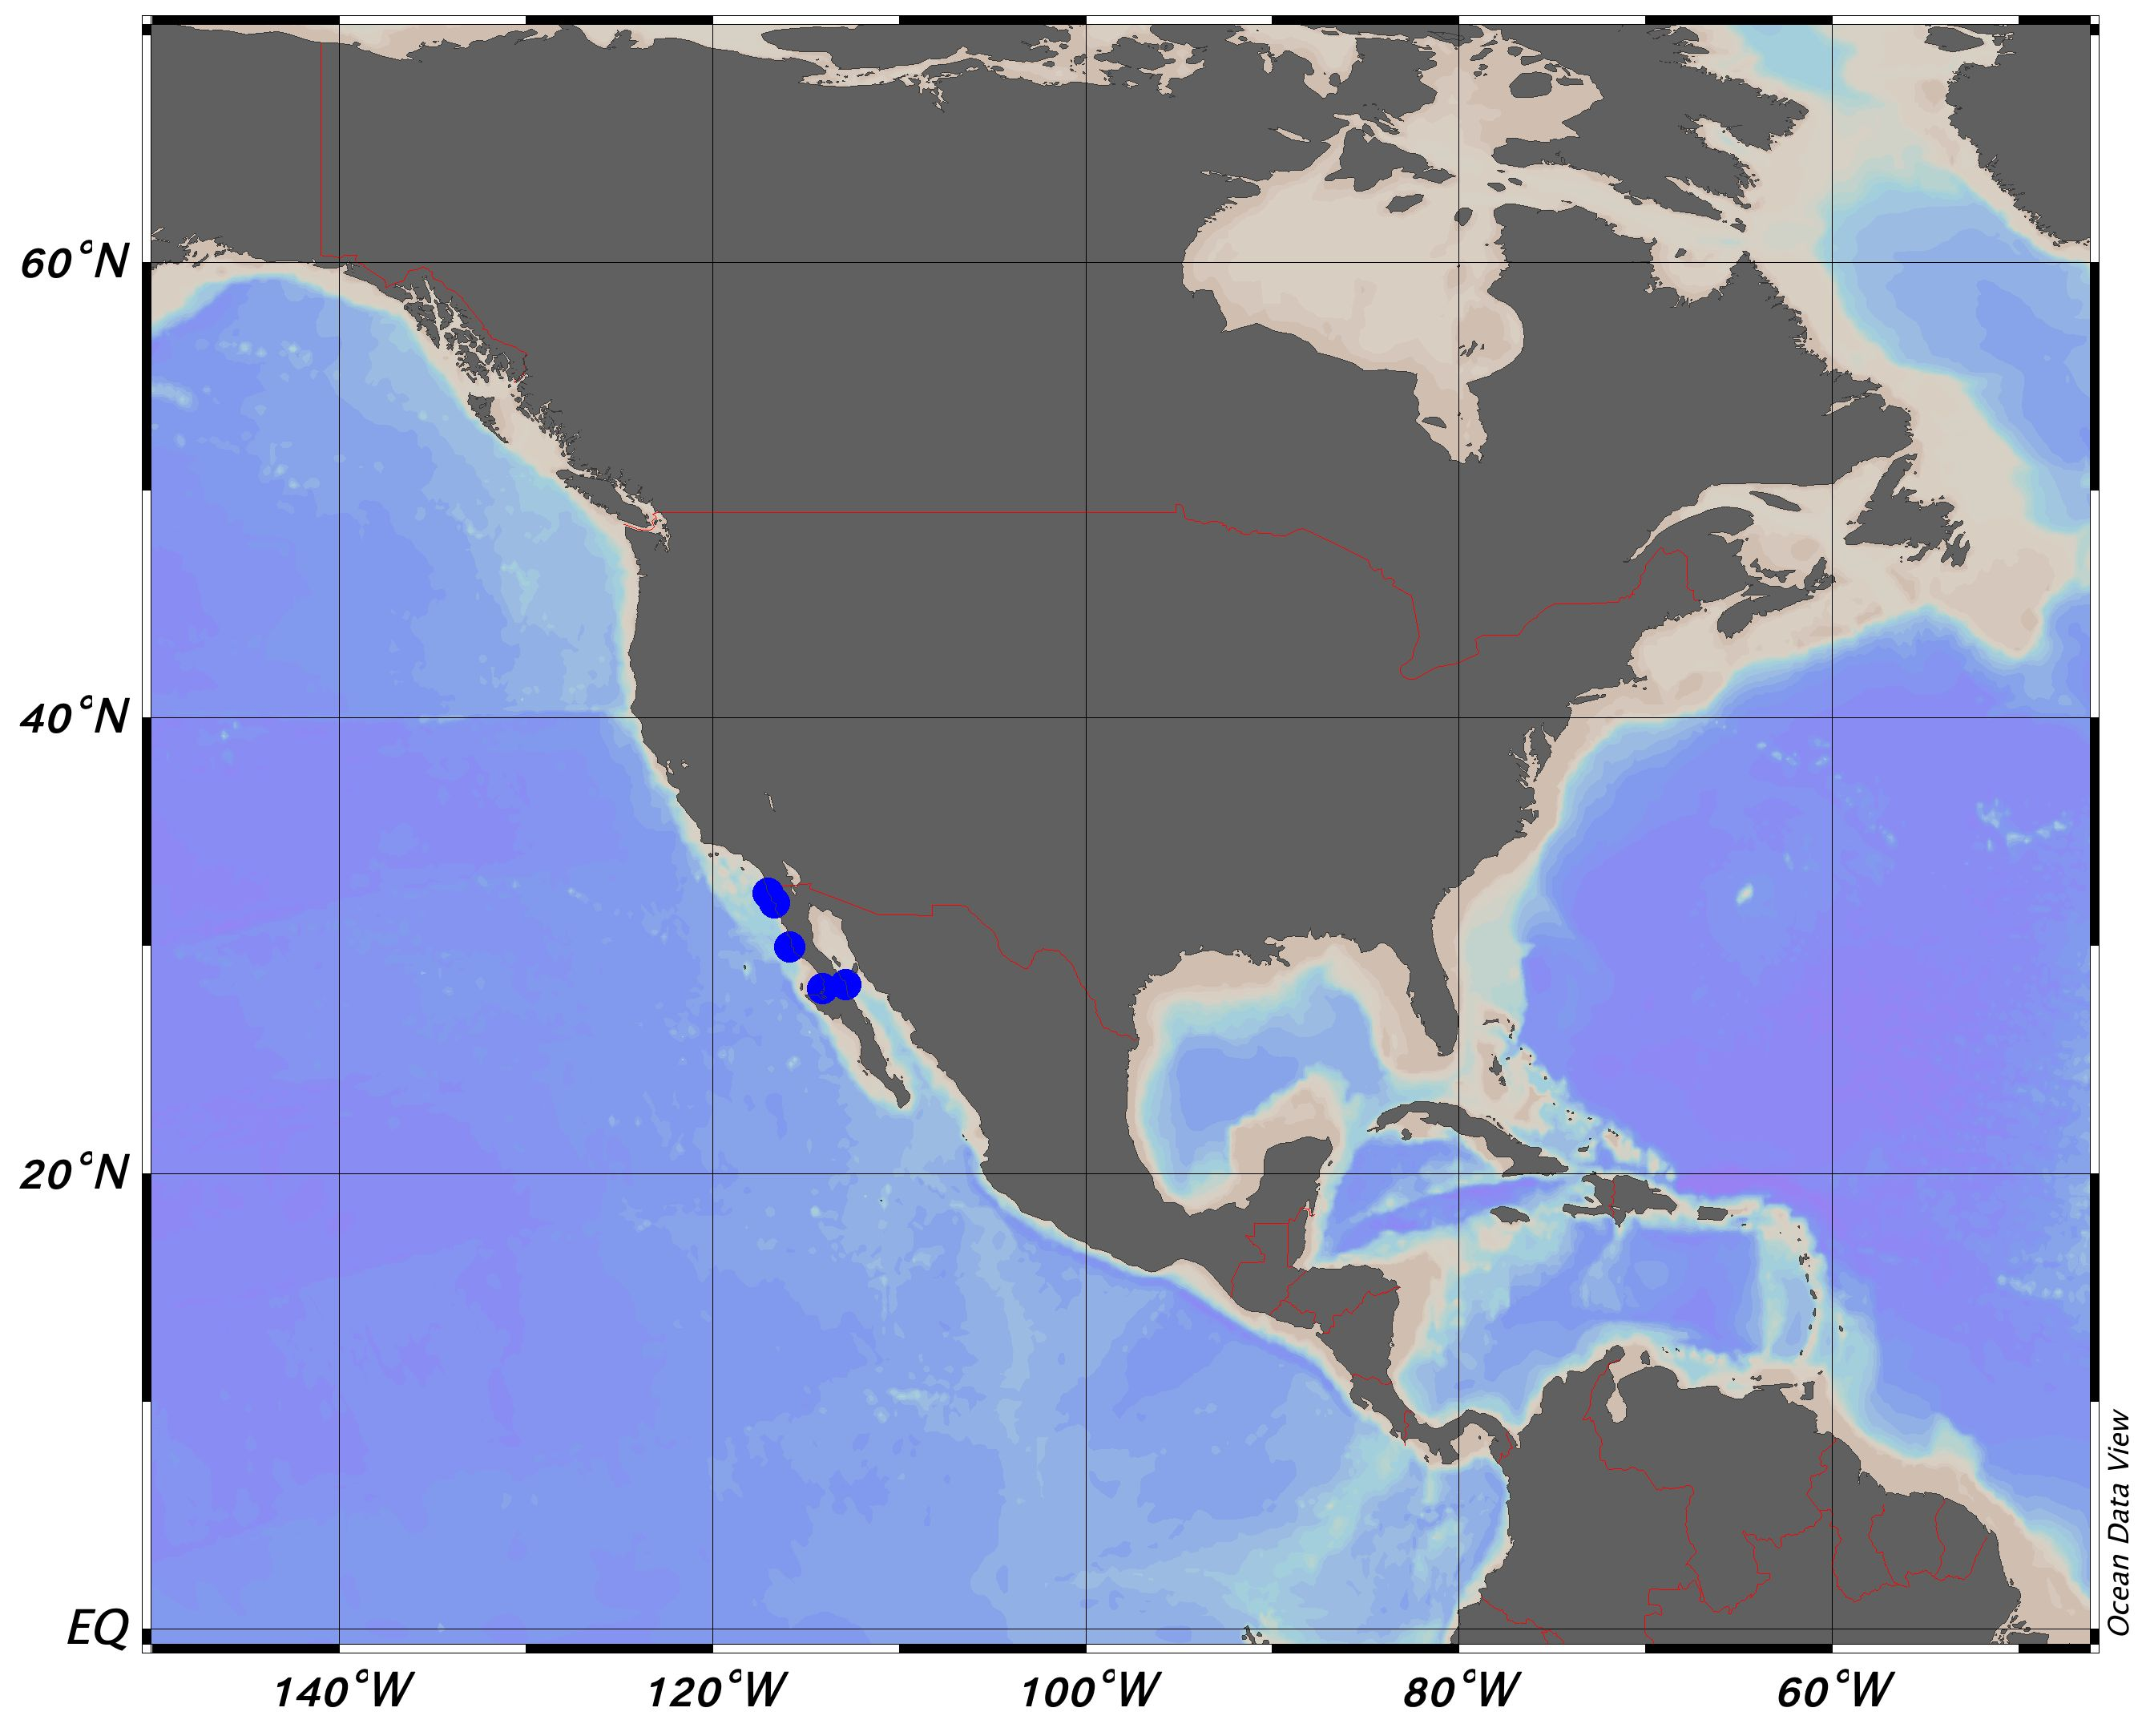
Study region
Notes:
Samples collected from artisanal fisheries on the Baja peninsula

Slide 8
Incidental capture
Sharks were sampled under permits:
SGPS/DGVS/04180/13 SGPS/DGVS/06243/14 SGPS/DGVS/06777/15 SGPS/DGVS/06294/16 SGPS/DGVS /07290/17
Issued by the General Direction of Wildlife from the National Ministry of Environment and Natural Resources
Notes:
Incidental capture by artisanal fisheries
2010-2017

Slide 9
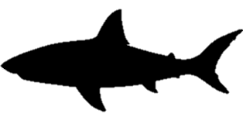
Incidental capture
Region | Site | Total length (cm) | Life stage
Northern Baja | Popotla | 133 | Neonate
Northern Baja | Ensenada | 170 | YOY
Northern Baja | Popotla | 188 | Juvenile
Northern Baja | Popotla | 194 | Juvenile
Northern Baja | Popotla | 200 | Juvenile
Northern Baja | El Rosario | 280 | Juvenile
Vizcaino Bay | Las Casitas | 139 | Neonate
Vizcaino Bay | Las Casitas | 160 | Neonate
Vizcaino Bay | Las Casitas | 165 | YOY
Vizcaino Bay | Laguna Manuela | 165 | YOY
Vizcaino Bay | Las Casitas | 170 | YOY
Gulf of California | El Barril | 289 | Juvenile
Gulf of California | El Barril | 305 | Subadult
Gulf of California | El Barril | 355 | Subadult
N=6
Notes:
Incidental capture by artisanal fisheries
2010-2017

Slide 10
Incidental capture
Region | Site | Total length (cm) | Life stage
Northern Baja | Popotla | 133 | Neonate
Northern Baja | Ensenada | 170 | YOY
Northern Baja | Popotla | 188 | Juvenile
Northern Baja | Popotla | 194 | Juvenile
Northern Baja | Popotla | 200 | Juvenile
Northern Baja | El Rosario | 280 | Juvenile
Vizcaino Bay | Las Casitas | 139 | Neonate
Vizcaino Bay | Las Casitas | 160 | Neonate
Vizcaino Bay | Las Casitas | 165 | YOY
Vizcaino Bay | Laguna Manuela | 165 | YOY
Vizcaino Bay | Las Casitas | 170 | YOY
Gulf of California | El Barril | 289 | Juvenile
Gulf of California | El Barril | 305 | Subadult
Gulf of California | El Barril | 355 | Subadult
N=5
Notes:
Incidental capture by artisanal fisheries
2010-2017

Slide 11
Incidental capture
Region | Site | Total length (cm) | Life stage
Northern Baja | Popotla | 133 | Neonate
Northern Baja | Ensenada | 170 | YOY
Northern Baja | Popotla | 188 | Juvenile
Northern Baja | Popotla | 194 | Juvenile
Northern Baja | Popotla | 200 | Juvenile
Northern Baja | El Rosario | 280 | Juvenile
Vizcaino Bay | Las Casitas | 139 | Neonate
Vizcaino Bay | Las Casitas | 160 | Neonate
Vizcaino Bay | Las Casitas | 165 | YOY
Vizcaino Bay | Laguna Manuela | 165 | YOY
Vizcaino Bay | Las Casitas | 170 | YOY
Gulf of California | El Barril | 289 | Juvenile
Gulf of California | El Barril | 305 | Subadult
Gulf of California | El Barril | 355 | Subadult
N=3
Notes:
Incidental capture by artisanal fisheries
2010-2017

Slide 12
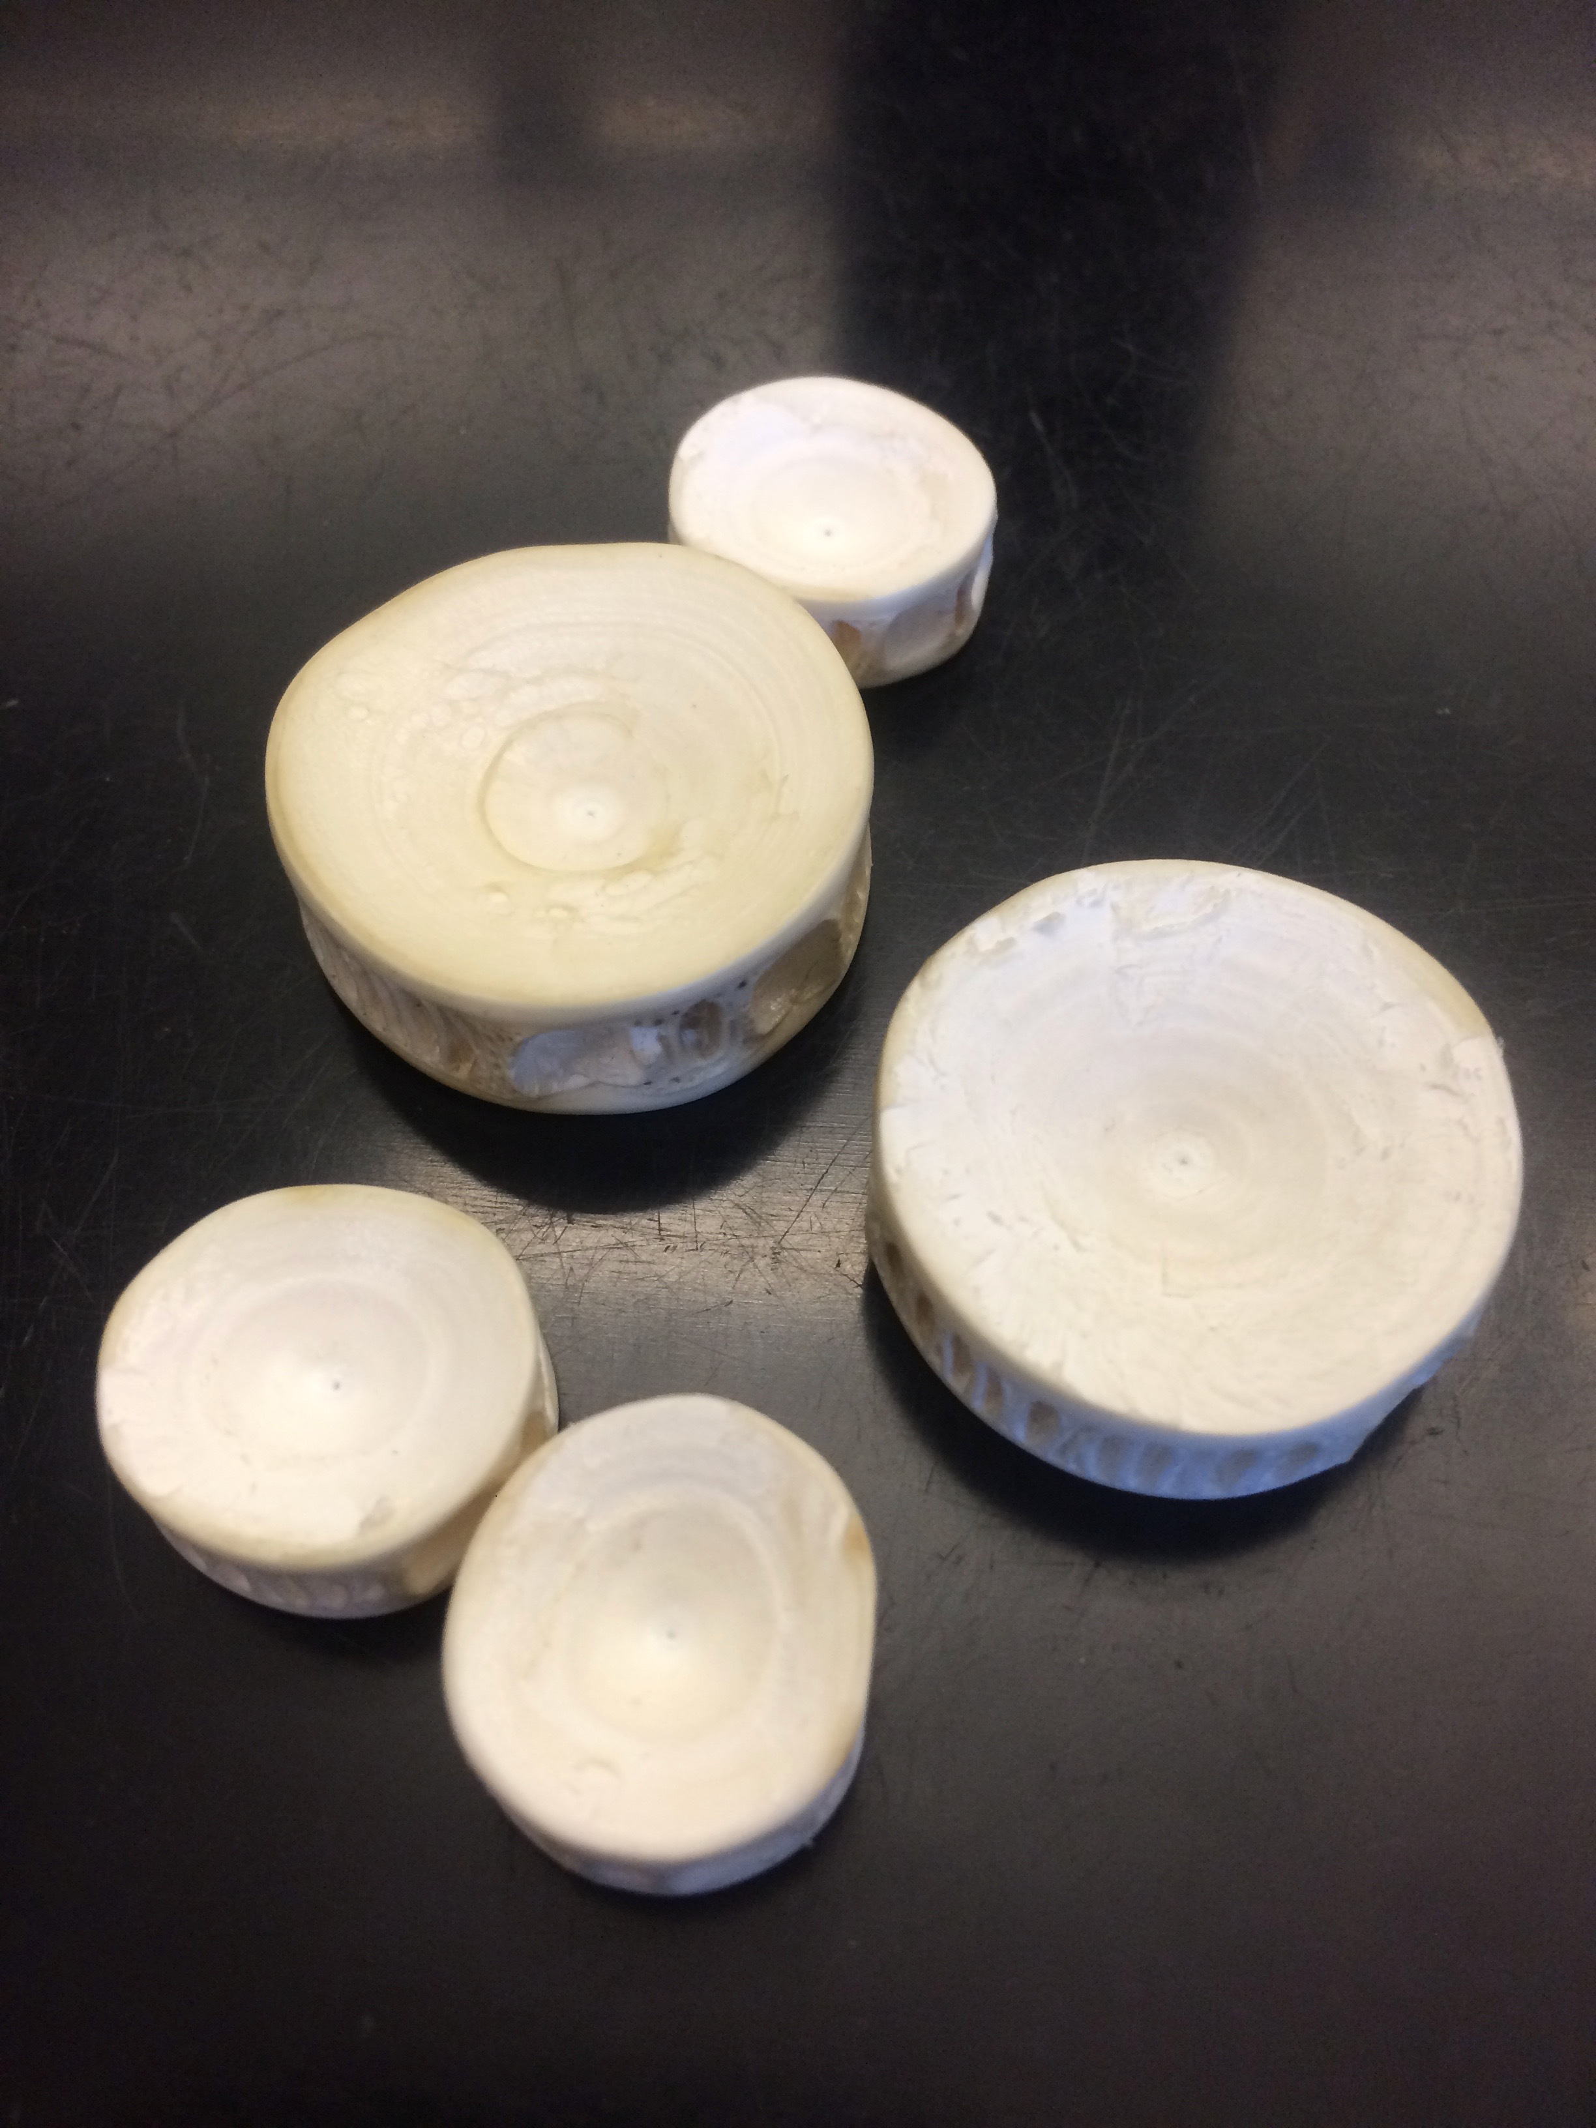
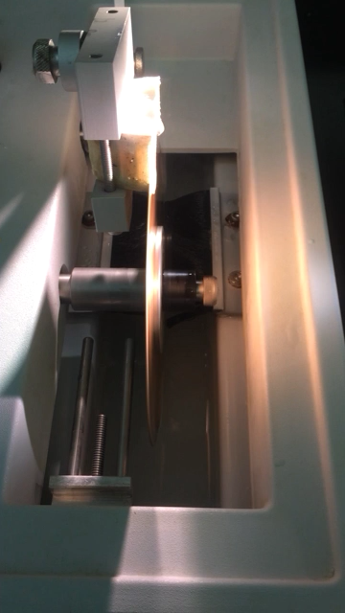
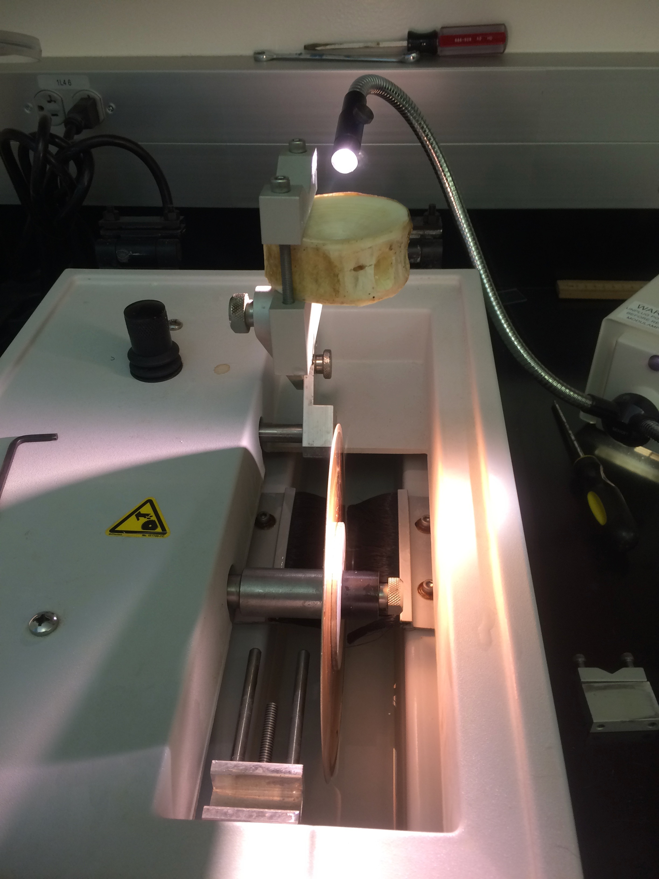
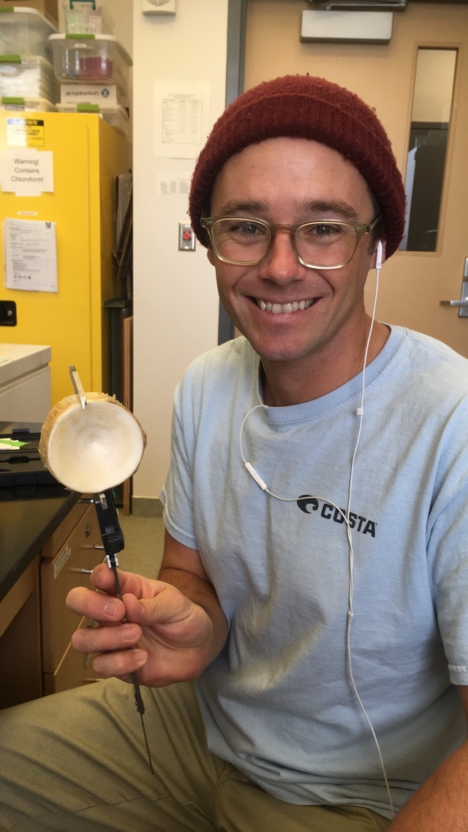
Vertebrae preparation
Notes:
Vertebrae centra air dried
Measured,
Sectioned in a longitudinal plane

Slide 13
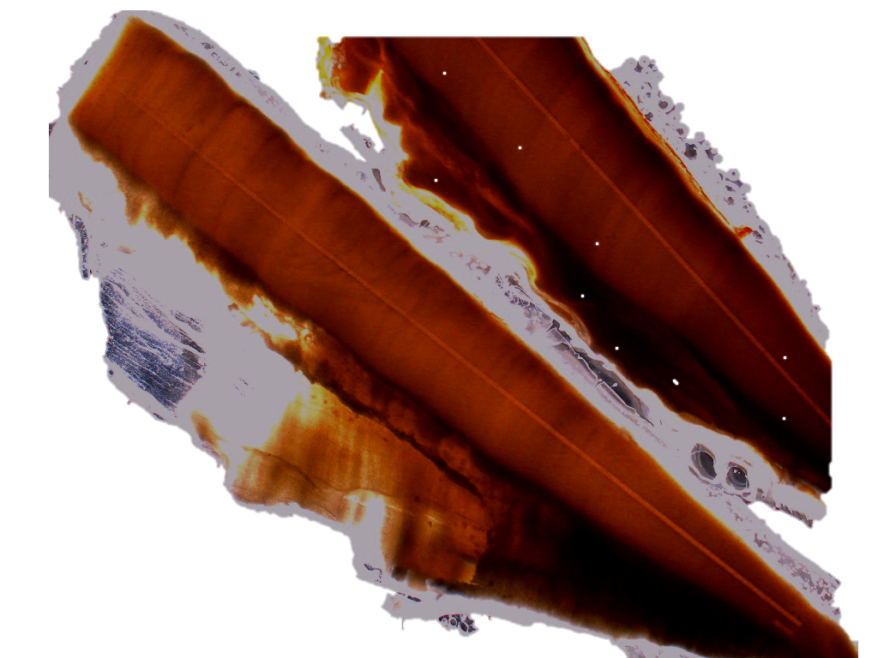
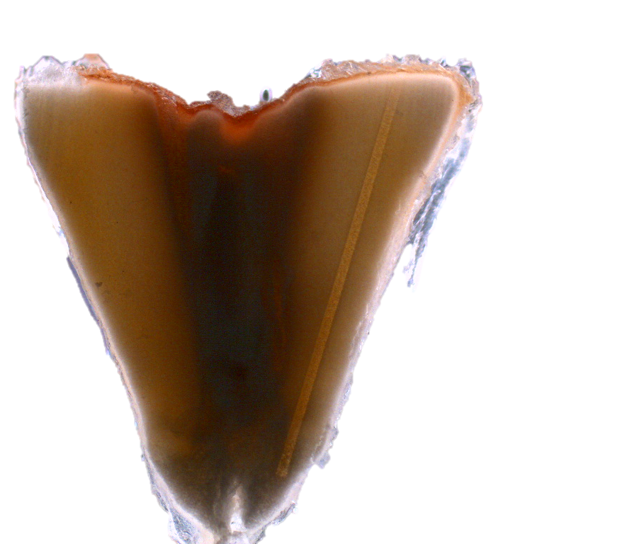
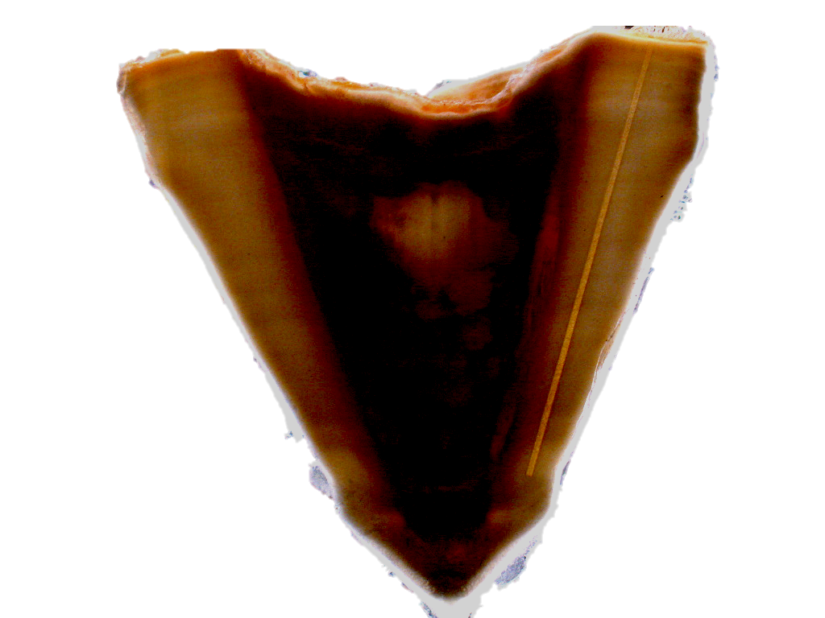
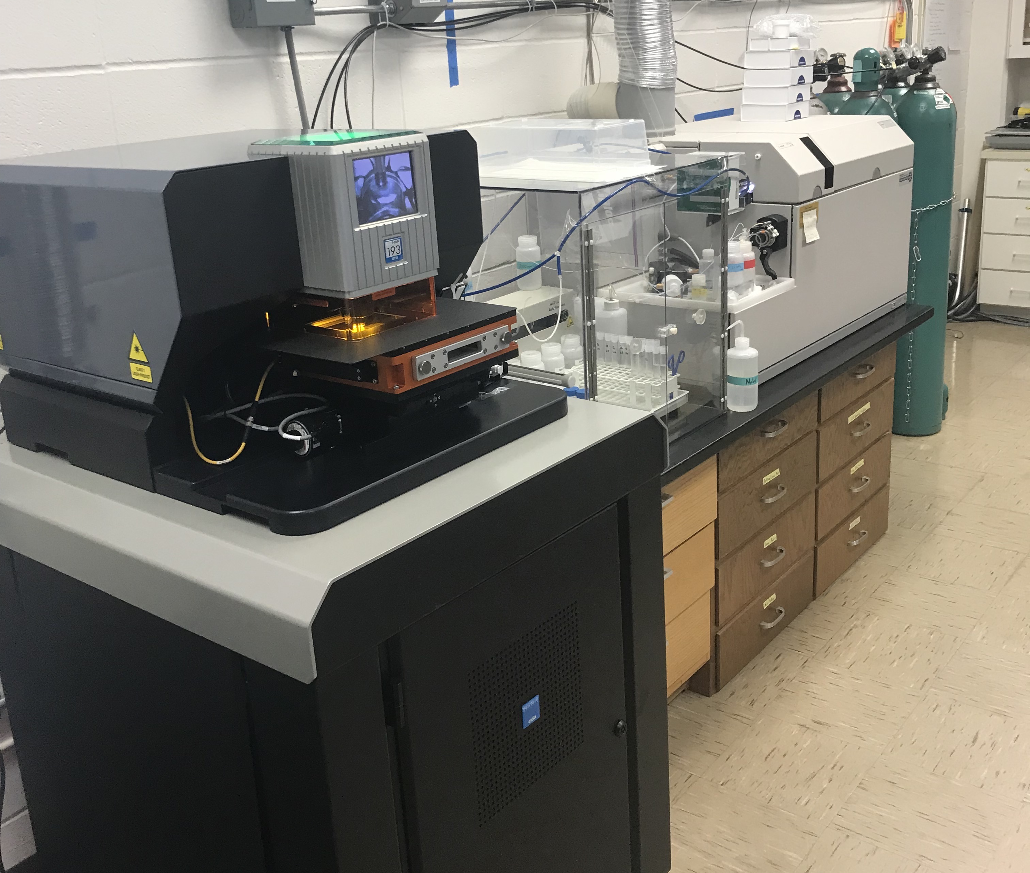
Vertebrae analysis
Juvenile/subadults (N=7)
Neonates (N=3)
Young-of-year (YOY) (N=4)
2 mm
2 mm
25x100 (µm) spot, 10 Hz rep rate
5 µm/s scan speed
Li, Mg, Mn, Zn, Sr, Ba,
5 mm
Notes:
25x100 (µm) spot, 10Hz rep rate
5 µm/s scan speed

Slide 14
Vertebrae analysis
following Oñate-González et al. (2017)
Notes:
25x100 (µm) spot, 10Hz rep rate
5 µm/s scan speed

Slide 15
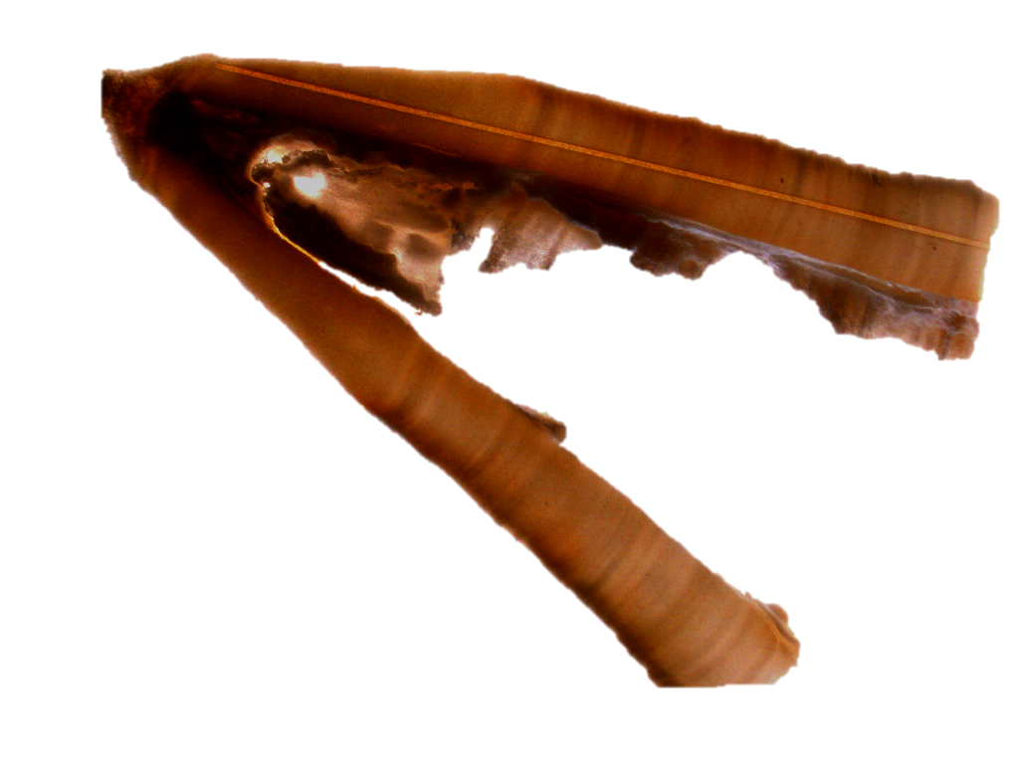
Vertebrae ontogenetic regions
Birth band
5 mm
Notes:
WT08 –

Slide 16
Vertebrae ontogenetic regions
Maternal region
5 mm
Notes:
Usefulness
Age and growth
Maternal region

Slide 17
Vertebrae ontogenetic regions
Birth band
Maternal region
5 mm
Notes:
Usefulness
Age and growth
Maternal region

Slide 18
Vertebrae ontogenetic regions
Post birth
Time series
Maternal region
5 mm
Notes:
Usefulness
Age and growth
Maternal region

Slide 19
Vertebrae ontogenetic regions
Post birth
Time series
Edge pre-capture
(500 µm)
Maternal region
5 mm
Notes:
Usefulness
Age and growth
Maternal region

Slide 20
Results

Slide 21
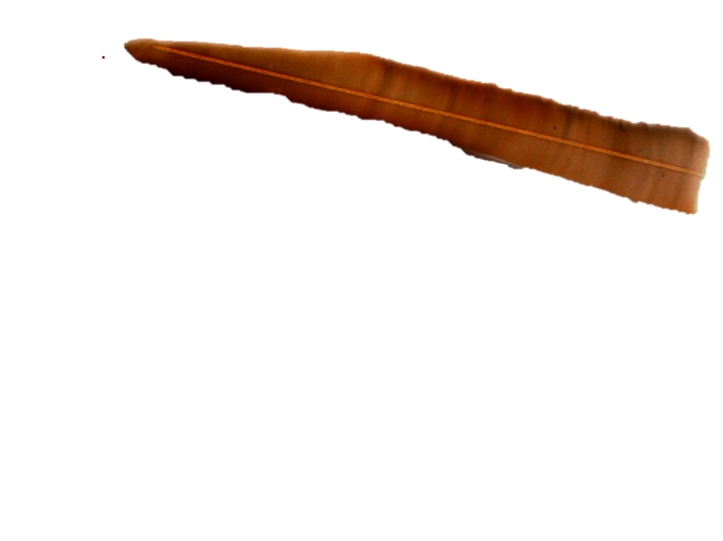
Maternal: Li:Ca
Gulf of California

Slide 22
Maternal: Li:Ca
Northern Baja

Slide 23
Maternal: Li:Ca
Vizcaino
Bay

Slide 24
Maternal: Mg:Ca
Notes:
Mg increases getting close to birth band

Slide 25
Maternal: Mn:Ca

Slide 26
Maternal: Zn:Ca

Slide 27
Maternal: Sr:Ca

Slide 28
Maternal: Ba:Ca

Slide 29
Spatial sampling sites

Slide 30
Life history Li:Ca
*2 Neonates excluded

Slide 31
Life history Li:Ca

Slide 32
Life history Mg:Ca

Slide 33
Life history Mn:Ca

Slide 34
Life history Zn:Ca

Slide 35
Life history Sr:Ca

Slide 36
Life history Ba:Ca

Slide 37
Ontogenetic shifts: maternal vs edge?

Slide 38
Ontogenetic shifts: maternal vs edge
Calculate average of elemental transect data
Non-parametric Kruskal-Wallis ANOVA
Dunn’s multiple comparison

Slide 39
Maternal: Li:Ca
maternal

Slide 40
Maternal vs edge: Li:Ca
maternal
pre capture (edge)

Slide 41
Maternal: Mg:Ca
maternal

Slide 42
Maternal vs edge: Mg:Ca
maternal
pre capture (edge)

Slide 43
Maternal: Mn:Ca
maternal

Slide 44
Maternal vs edge: Mn:Ca
maternal
pre capture (edge)

Slide 45
Maternal: Zn:Ca
maternal

Slide 46
Maternal vs edge: Zn:Ca
maternal
pre capture (edge)

Slide 47
Maternal: Sr:Ca
maternal

Slide 48
Maternal vs edge: Sr:Ca
maternal
pre capture (edge)

Slide 49
Maternal: Ba:Ca
maternal

Slide 50
Maternal vs edge : Ba:Ca
maternal
pre capture (edge)

Slide 51
Discussion
Sharp edge increases – zone of active biomineralization?
Distinct regional vertebral chemistry variation
  Maternal Li, Ba and Zn differed significantly
  Juvenile/sub adult edge (pre-capture) Ba and Zn
Oscillations in Mn, Zn, Sr, and Ba
  Related to band pair formation?
Elasmobranch research should focus on vertebrae chemistry and mechanisms of biomineralization
  Physiology versus environmental

Slide 52
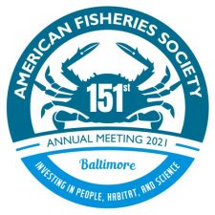


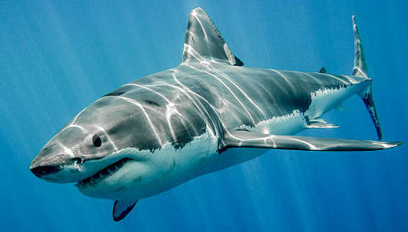
Inferring potential feeding areas from stable isotope analysis in Pacific White Shark vertebrae
Related virtual presentation:
https://www.istockphoto.com/es/fotos/white-shark
Alfonsina E. Romo-Curiel¹, Sharon Z. Herzka¹, Oscar Sosa-Nishizaki¹, John A. Mohan^{2,3}, Emiliano García-Rodríguez¹, R. J. David Wells²
1 Departamento de Oceanografía Biológica, CICESE, México
2 Department of Marine Biology, Texas A&M University at Galveston, USA
3 School of Marine and Environmental Programs, University of New England, USA

Slide 53
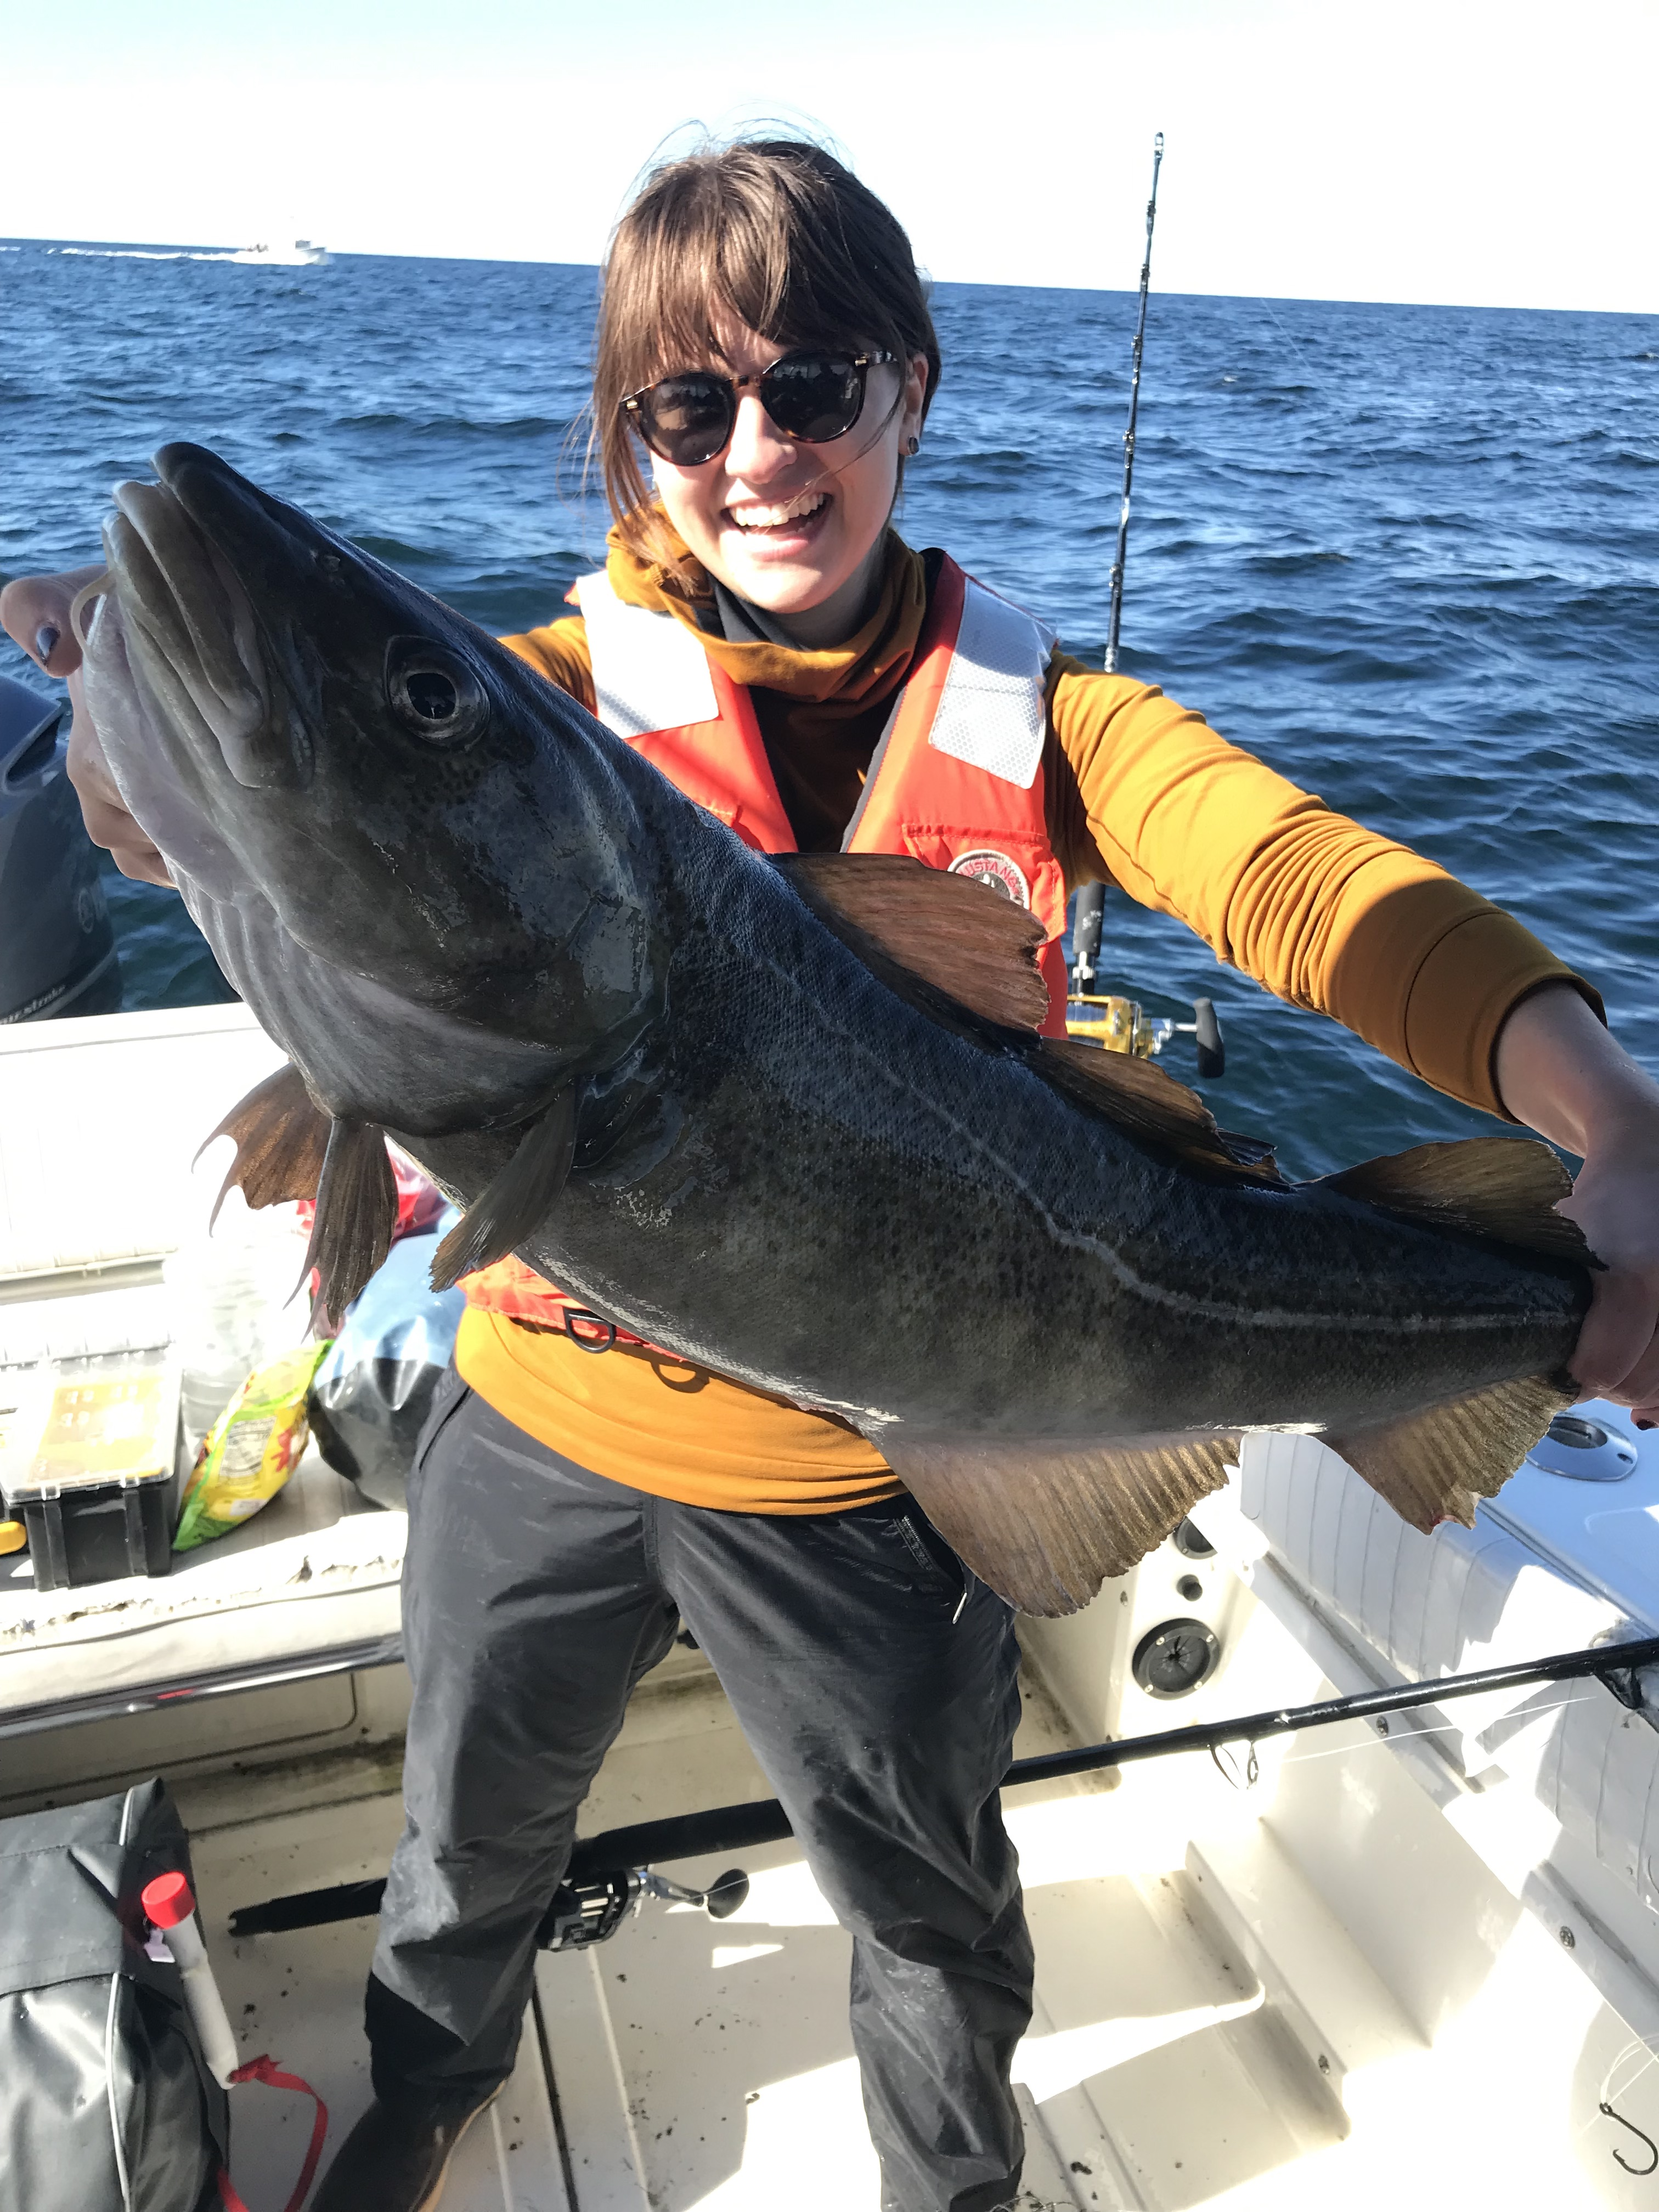
Related poster presentation:
Poster session Sunday Key Ballroom 5:30-7:30
Exploring element patterns in shark vertebrae cartilage to enhance understanding of biomineralization – Abigail Hayne

Slide 54
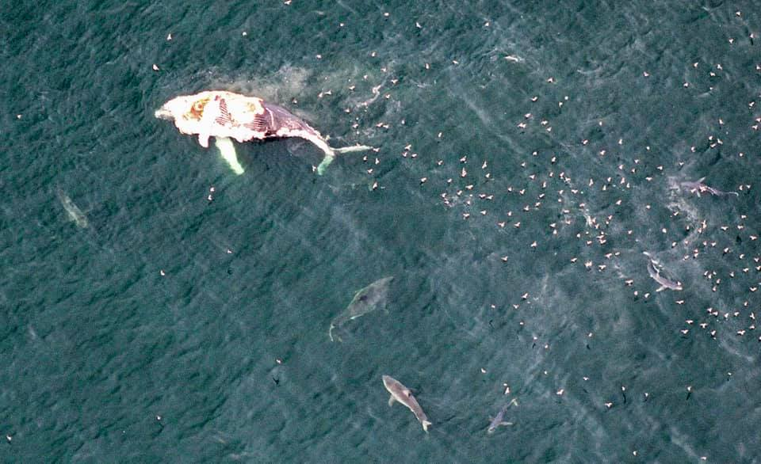
Questions? jmohan@une.edu

