Slide 1
November 2022
Recruiting summer staff for geoforce 2023
Alexa Palmer
GeoFORCE Outreach Coordinator, The University of Texas at Austin

Slide 2
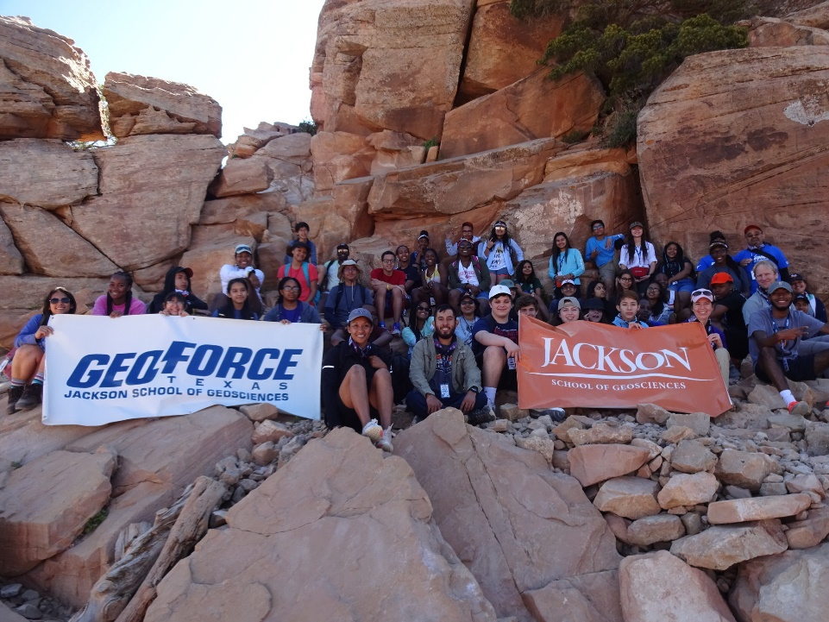
What is GeoFORCE?
A completely free 4-year high school diversity outreach program at the UT Austin Jackson School of geosciences
Designed to increase the number of students pursuing STEM degrees in college, especially the geosciences
Help our students move on to rewarding careers

Slide 3
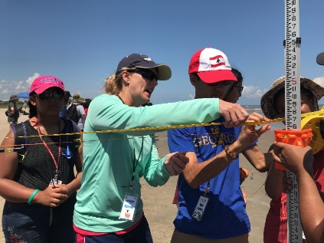
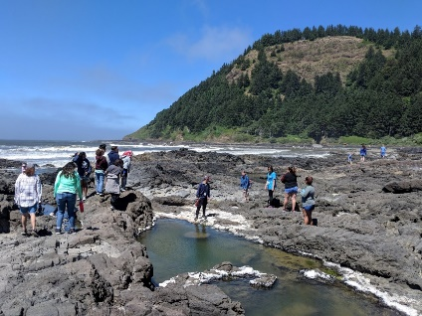
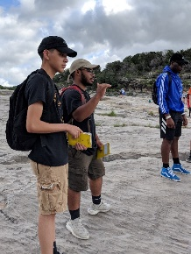
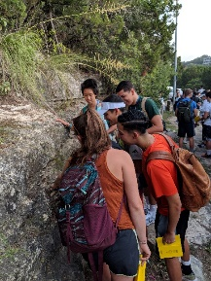
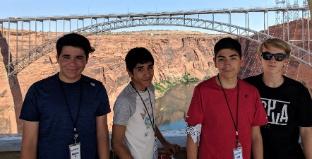
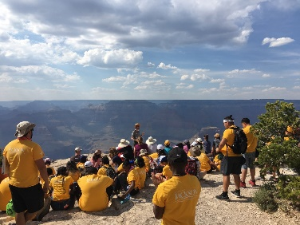
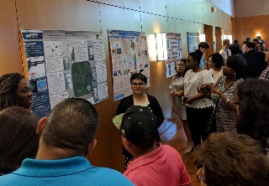
9th Grade Academy: Active Coastal Processes
Oregon & Washington
11th Grade Academy: Igneous Processes & Hazards
Texas Gulf Coast
Mount St. Helens
Cape Perpetua
plate tectonics, volcanoes, volcanic rocks,
cross-cutting relationships, tsunamis
sedimentary processes, coastal change, barrier islands, hurricanes, engineered structures
Instructor Tiffany Caudle (Bureau of Economic Geology)
12th Grade Academy:
10th Grade Academy: Reading the Rock Record
Telling the Geologic History of Central Texas
The American Southwest
Central Texas
Hill Country
sedimentary rocks and processes, sea level change, fluvial processes, geochronology and geologic time, hydroelectric power and dams
Group Projects and Presentations
metamorphism & deformation, water resources, life through time, science communication
Grand Canyon National Park
Pedernales Falls State Park
Glen Canyon Dam
Mount Bonnell

Slide 4
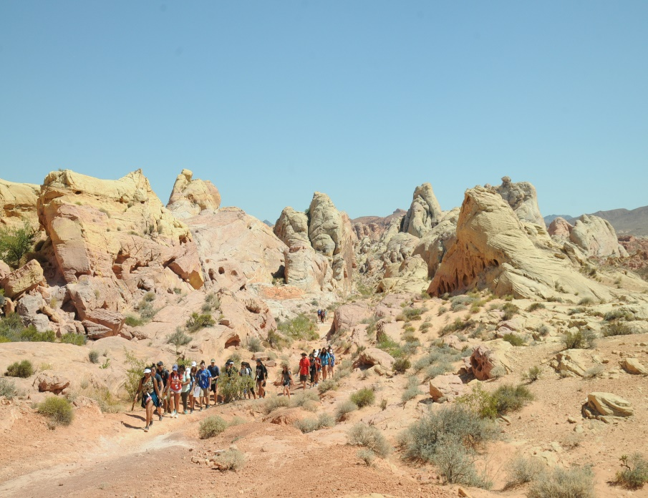
High School Pipeline/Pathway Program
Field Component
Support through early workforce
Zero cost to students
Industry Sponsorships & Mentors
Small Cohorts of Students
GeoFORCE is an outreach program designed to introduce and expose diverse high school youth to STEM fields, especially geoscience, through in-person and virtual field experiences.
GeoFORCE continues support for alumni of the program through early career stages with programs focusing on the transition to college, undergraduate research, and career development.
Notes:
GeoFORCE is a K-12 outreach program of the Jackson School of Geosciences designed to increase the number and diversity of students pursuing STEM degrees and careers, especially geology and engineering.
Each summer GeoFORCE takes high school students on spectacular geological field trips in Texas and throughout the United States.
Taught by university faculty, research scientists, area educators and mentored by professional geologists from our industry partners, the trips engage and empower the students by exposing them to something completely different from their home and school environment.
Once students graduate from high school, we continue to offer them resources to ensure success throughout college and support as they find a career.

Slide 5
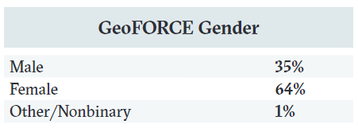
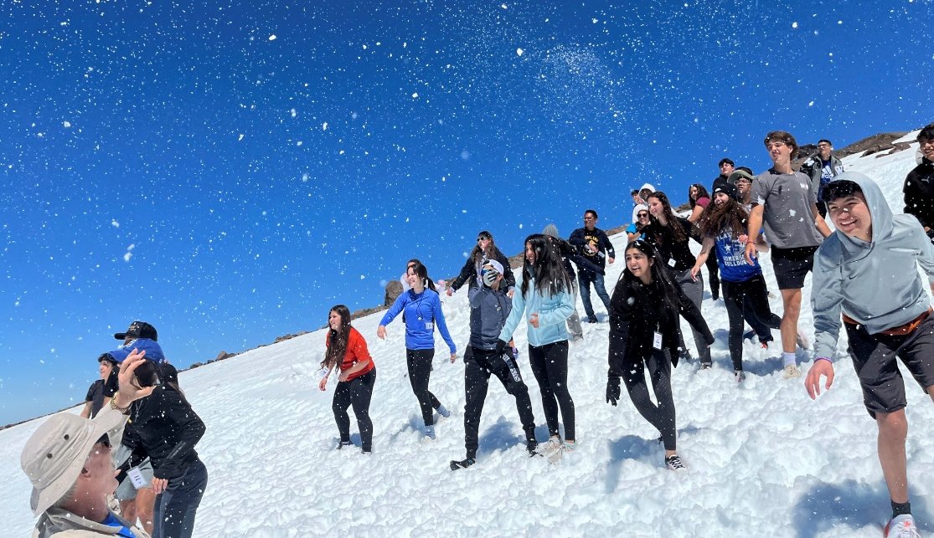
Who are GeoFORCE Students?

Slide 6
Virtual Cohort est. 2020
Accommodations for students of all abilities are made for in-person field academies
If a student would like to participate, we developed a virtual cohort where they learn the same material through Virtual field trips and interactive Zoom lectures.
Top students from the virtual cohort are accepted into their traveling cohort when spots open up

Slide 7
Interested in joining the GeoFORCE team?
We’re hiring for summer 2023:
Counselors
Education Coaches-in-Training
Education Coaches
Trail Drivers
Instructors
Volunteer positions
- Professional mentor (Volunteer only)
- Alumni mentor (Volunteer only)
- You can choose to volunteer for any position. GeoFORCE will provide documentation to organizations or programs that require volunteer hours.
Lodging and academy travel included
All positions must attend training in spring and will be responsible for travel to starting location

Slide 8
Counselors
Responsibilities: conduct regular head counts and nightly room checks, safely guide group to learning areas, assist with study material, monitor student behavior and encourage participation
Qualifications: recent graduate or currently enrolled in four-year college, ability to work independently or cooperatively, ability to work with diverse populations
Pay: $18/hour

Slide 9
Education Coaches-in-Training
Responsibilities: assist with classroom activities for a group of 5 to 7 students, assist assigned students in their group project and with geological content objectives, monitor student behavior, perform regular headcounts
Qualifications: recent graduate or currently enrolled in four-year college, ability to assist in teaching complex geologic concepts and guide students in their learning, ability to work with diverse populations
Pay: $20/ hour (60 hours / week expected)

Slide 10
Education Coaches
Responsibilities: develop and lead classroom activities for students, monitor student comprehension and clarify points of confusion, lead in-classroom and in-field small group activities, guide counselors and ECITs in reviewing and grading assignments
Qualifications: Bachelor's degree or higher in geosciences or related field, ability to work with diverse populations, classroom experience preferred
Pay: $25/ hour (40 hours / week expected)

Slide 11
Trail Drivers
Responsibilities: Drive trail vehicle throughout the duration of the field academy, purchase snacks/ drinks/ food daily and transport them to each field stop, compile receipts daily, provide any necessary emergency transportation, take pictures
Qualifications: valid driver’s license and clean driving record, ability to work independently or cooperatively, ability to work with diverse populations
Pay: $20/hour (84 hours/week expected)

Slide 12
Instructors
Responsibilities: Deliver lectures to GeoFORCE students, act as geosciences content expert in the field, conduct daily debriefs of each day's activities and plan instructional material for the following day
Qualifications: Two or more years of post-baccalaureate education (PhD in geosciences or related field preferred), ability to communicate effectively with diverse populations, experience with secondary school science enrichment preferred
Pay: $40/ hour

Slide 13
The Application Process
GeoFORCE Texas utilizes a blind review process for applicants.
The University of Texas at Austin, as an equal opportunity/affirmative action employer, complies with all applicable federal and state laws regarding nondiscrimination and affirmative action.
GeoFORCE Texas is committed to a policy of equal opportunity for all persons and will not discriminate on the basis of race, color, national origin, age, marital status, sex, sexual orientation, gender identity, gender expression, disability, religion, or veteran status in employment, educational programs and activities, and admissions.
Research indicates that applicants with marginalized identities are hesitant to apply for positions if they do not meet all of the qualifications. We want to emphasize that the preferred qualifications are not required and that we are committed to helping our future colleague develop these preferred skills.

Slide 14
Want more information?
Our website: https://www.jsg.utexas.edu/geoforce/
Application will open November 15th
Link to our applications on website under "Summer Academies" > "Summer Staff"
Email: geoforce@jsg.utexas.edu

Slide 15
But Alexa, how do you feel about shameless self-promotion?

Slide 16
Great! Follow us on all the things:
Facebook: GeoFORCE Texas
Instagram: @geoforce_texas
Snapchat: GeoFORCE_Texas
Twitter: @geoforcetexas

Slide 17
Thank you for listening. Do you have any questions for us?

