Slide 1
Climate change and the water resources of the western U.S.
Dennis P. Lettenmaier
Department of Civil and Environmental Engineering
University of Washington
University of Texas Austin
Center for Integrated Earth System Science Seminar Series
March 25, 2013

Slide 2
Outline
The hydrology of the western U.S. is changing
Global and regional perspectives on future climate projections
Widely varying projections of future Colorado River streamflows
Understanding hydrologic sensitivities to climate change – the Colorado River basin as a case study
Water management implications
Preview of IPCC AR5 climate simulations with respect to Colorado River streamflows

Slide 3
1. The hydrology of the western U.S. is changing

Slide 4
from Mote et al, BAMS 2005

Slide 5
From Stewart et al, 2005

Slide 6
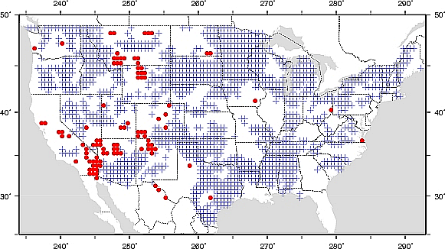
Soil Moisture Annual Trends
Positive trends for ~45% of CONUS (1482 grid cells)
Negative trends for ~3% of model domain (99 grid cells)
Positive +
Negative

Slide 7
Trends in annual precipitation maxima in 100 largest U.S. urban areas, 1950-2009
from Mishra and Lettenmaier, GRL 2011

Slide 8
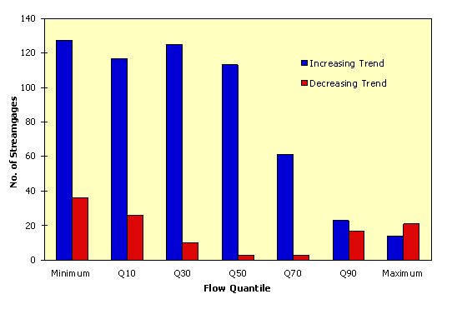
Number of statistically significant increasing and decreasing trends in U.S. streamflow (of 395 stations) by quantile (from Lins and Slack, 1999)

Slide 9
2. Global and regional perspectives

Slide 10
Median runoff sensitivities per degree of global warming (averaged over 68 IPCC AR4 model pairs)
Runoff decreases by | 0% | 5% | 10% | 15%
% of world’s population | 33 | 26 | 22 | 21
% of world's GDP | 46 | 55 | 55 | 51
from Tang et al., GRL, 2012

Slide 11
Tang et al (2012) results of the USGS water resources regions of the Continental U.S. and Alaska
from Tang et al., GRL, 2012

Slide 12
3. Widely varying predictions (projections) of future Colorado River streamflows

Slide 13
Sensitivity of projected change in runoff to spatial resolution
from Seager et al, Science, 2007

Slide 14
Lake Level Declines
Imagery from http://www.nasa.gov/vision/earth/lookingatearth/Lake_Mead2004.html
Notes:
From Jenny Adam students
http://www.nasa.gov/vision/earth/lookingatearth/Lake_Mead2004.html

Slide 15
Why is there such a wide range of projections of impacts of future climate change on Colorado River streamflow?

Slide 16
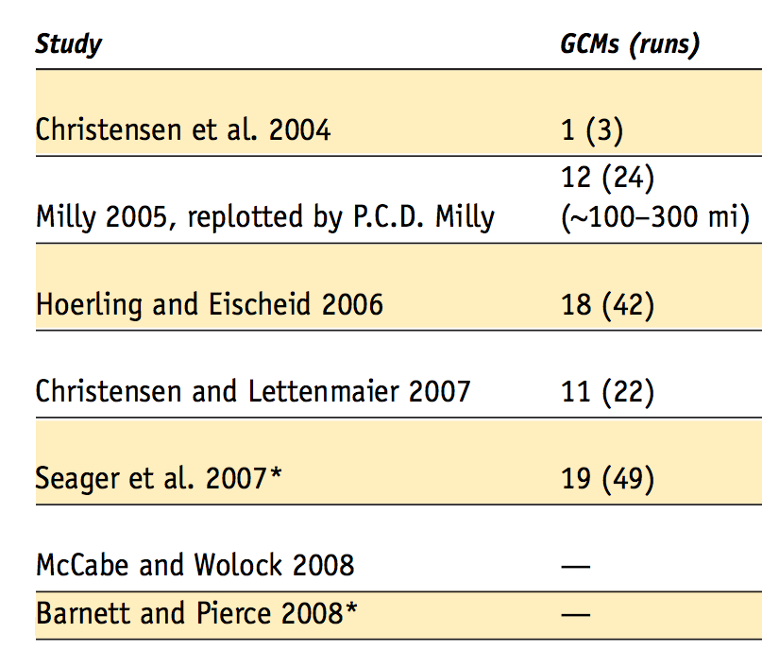
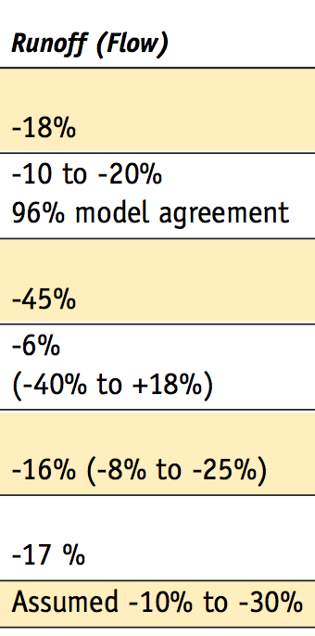
Past Studies
Information from Table 5-1 in Western Water Assessment (WWA) report for Colorado Water Conservation Board “ Colorado Climate Change: A Synthesis to Support Water Resource Management and Adaptation.” Oct 2008 (available online at: http://cwcb.state.co.us/NR/rdonlyres/8118BBDB-4E54-4189-A354-3885EEF778A8/0/CCSection5.pdf)

Slide 17
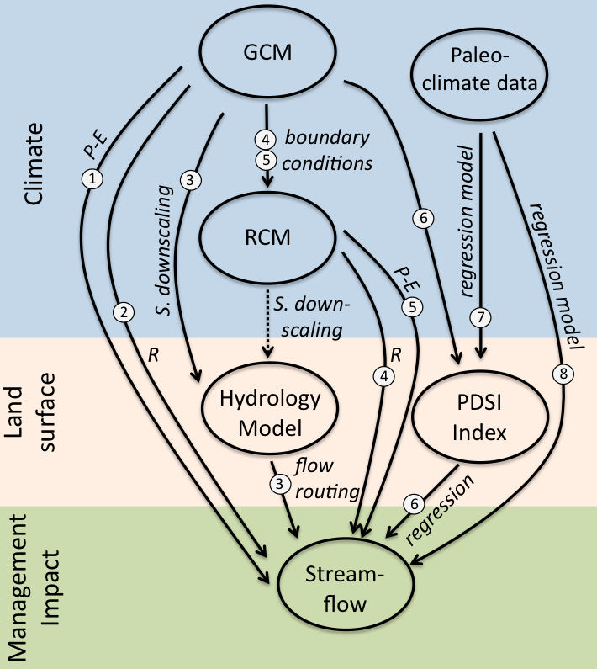
Studies using various approaches:
Seager et al. 2007; Seager et al. 2013
Milly et al. 2005
Christensen et al. 2004; Christensen and Lettenmaier, 2007; Cayan et al. 2010; USBR 2011
Gao et al. 2011; Rasmussen et al. 2011
Gao et al. 2012
Hoerling and Eischeid 2007
Cook et al. 2004
Woodhouse et al. 2006; McCabe and Wolock 2007; Meko et al. 2007; USBR 2011
Abbreviations:
GCM – Global Climate Model
RCM – Regional Climate Model
PDSI – Palmer Drought Severity Index
P – Precipitation
T – Temperature
R – Runoff
E – Evaporation
S. downscaling – statistical downscaling
GCMs, Emission scenarios,
Time periods, Spatial resolution
Land surface representation
Approaches to generating climate projections. Dotted lines indicate future studies.
Figure from Vano et al., BAMS, in review

Slide 18
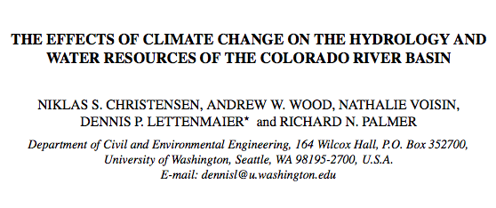
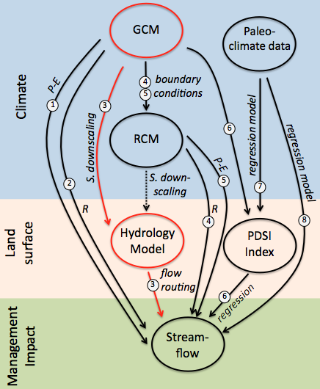
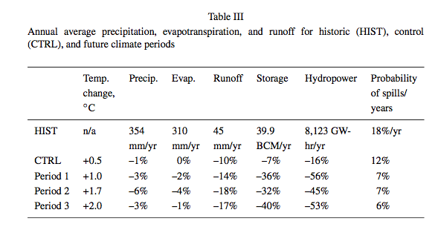
GCMs: 1 (PCM)
Emission scenarios: BAU
Total Projections: 3 (multiple runs)
Time periods: 2020s, 2050s, 2080s
Spatial resolution: 1/8° (~12 km)
Land surface: Hydrologic model (VIC)
estimate:
-18%
Notes:
An earlier study…

Slide 19
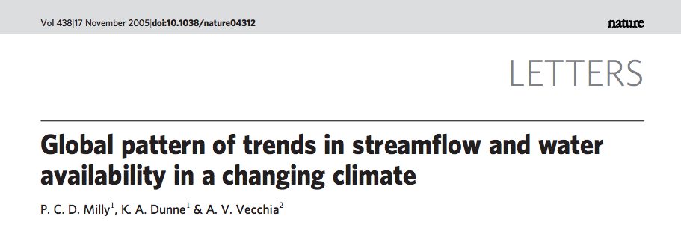
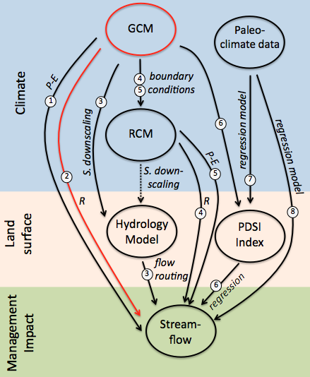
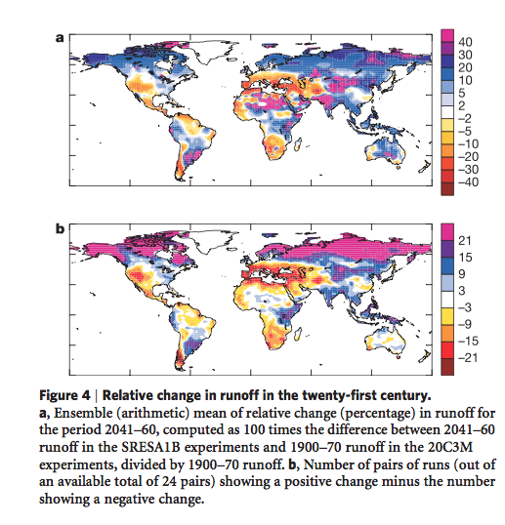
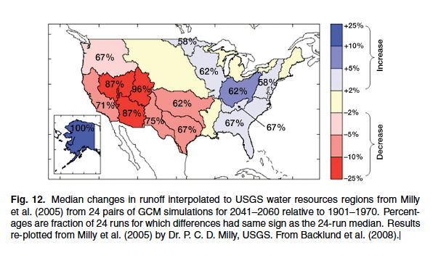
GCMs: 12
Emission scenarios: A1B
Total Projections: 24 (multiple runs)
Time period: 2041-2060
Spatial resolution: 2° (~200 km)
Land surface: GCM runoff
estimate:
-10 to -20%
Lower figure replotted from Milly et al. (2005), from Harding et al. (HESS, 2012).
Notes:
New figure from Harding et al. 2012

Slide 20
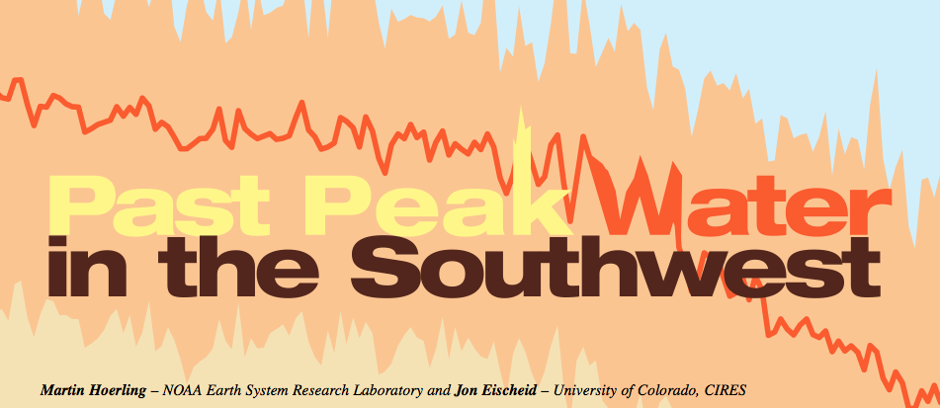
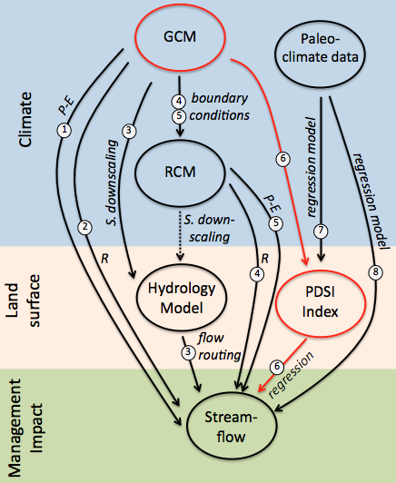
GCMs: 18
Emission scenarios: A1B
Total Projections: 42 (multiple runs)
Time period: 1900-2050
Spatial resolution: climate divisions (~150 km)
Land surface: PDSI Index with regression
estimate:
-45%
Notes:
Used 18 GCMs, but unclear to me how this translates to 42?

Slide 21
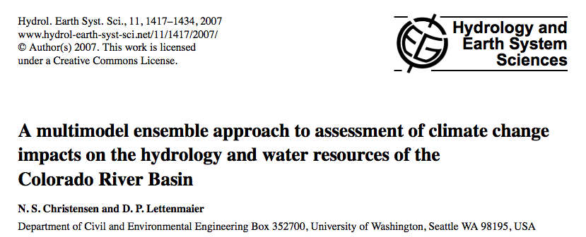
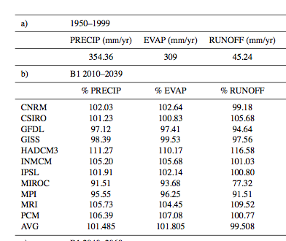
GCMs: 11
Emission scenarios: A2, B1
Total Projections: 22
Time period: 2020s, 2050s, 2080s
Spatial resolution: 1/8° (~12 km)
Land surface: Hydrologic model (VIC)
estimate:
-6% (-40 to +18%)

Slide 22
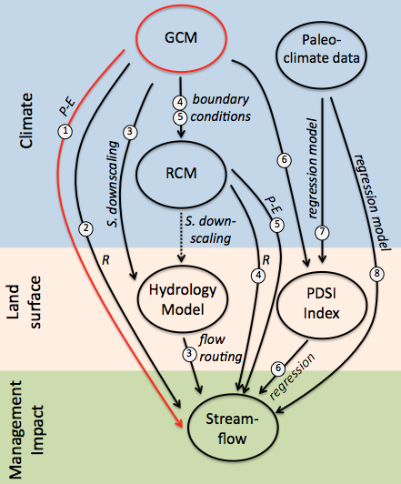
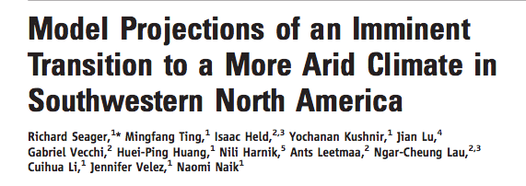
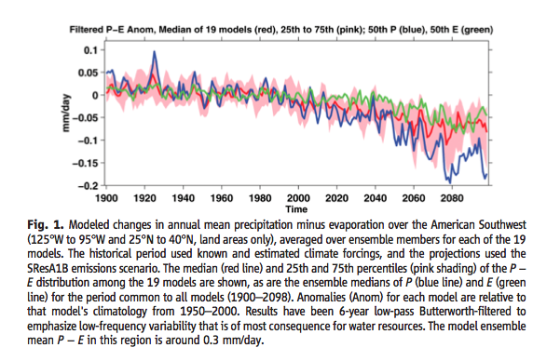
GCMs: 19
Emission scenarios: A1B
Total Projections: 49 (multiple runs)
Time period: 1900-2098
Spatial resolution: 2° (~200 km)
Land surface: GCM (P-E)
estimate:
-16% (-8 to -25%)
Notes:
A1B emissions

Slide 23
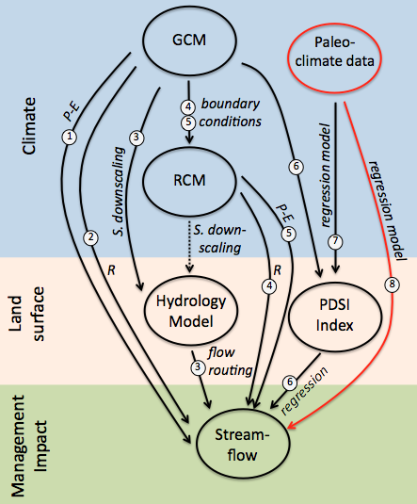
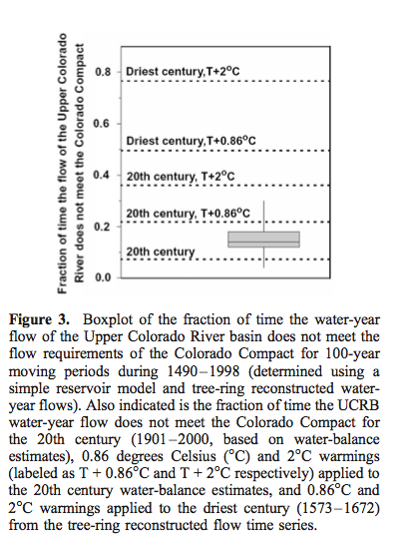
GCMs: estimated 2°C from GCMs and 0.86°C from current trend
Emission scenarios: NA
Total Projections: 2
Time period: 1490-1998
Spatial resolution: 62 HUC8s
Land surface:% adjustment based on simple water balance model and proxy reconstruction
Figure 2. Boxplot of mean water-year flow (mcm) for the Upper Colorado River basin for 100-year moving periods during 1490–1998 (determined using tree-ring reconstructed water-year flows). Also indicated are mean water-year UCRB flows for the 20th century (1901–2000, based on water-balance esti- mates), 0.86 degrees Celsius (°C) and 2°C warmings (labeled as T + 0.86°C and T + 2°C respectively) applied to the 20th century water-balance estimates, and 0.86oC and 2°C warmings applied to the driest century (1573–1672) from the tree-ring reconstructed flow time series.
estimate:
-17%
Notes:
The second approach was to apply the warming
scenarios to the driest century of reconstructed streamflow
in the tree-ring record. This can be viewed as a worst-case
scenario, in which a ‘‘naturally’’ very dry period is modified
consistent with the 0.86 and 2 C warming scenarios. It is
not possible to directly apply the warming scenarios to treering
reconstructed climate data because such climate data
for the UCRB do not exist. Instead, the reconstructed
streamflow values for the driest century in the tree-ring
record (1573–1672) were adjusted by average percentage
changes in estimated streamflow caused by the warming
scenarios applied to 20th century data. For example, the
0.86 C warming scenario applied directly to 20th century
climate caused an 8% decrease in streamflow (see next
section), so the reconstructed streamflow values were
decreased by 8% to represent a 0.86 C warming

Slide 24
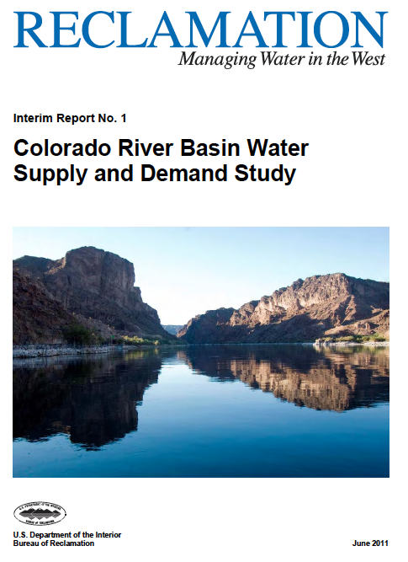
GCMs: 16
Emission scenarios: A2, A1B, B1
Total projections: 112 (multiple runs)
Time period: 1950-2099
Spatial resolution: 1/8° (~12 km)
Land surface: Hydrologic model (VIC)
estimate:
-15 to -20%

Slide 25
Why is there such a wide range of projections of impacts of future climate change on Colorado River streamflow, and how should this uncertainty be interpreted?

Slide 26
Sources of Uncertainty in Future Projections
Global Climate Model (GCM) and emission scenario selection
Spatial scale and topographic dependence of climate change projections
Land surface representations
Statistical downscaling methods
Notes:
Research Objectives: We compare the hydrologic sensitivities of five commonly used land-surface models to temperature and precipitation changes to better understand:
To what extent does the land-surface hydrology modulate or exacerbate regional scale sensitivities to global climate change?
How do these sensitivities vary spatially across the Colorado River basin?
How much of the range of results of these hydrologic sensitivities is attributable to model bias?

Slide 27
1) Global Climate Model (GCM) and emission scenario selection
(a) Different GCMs, A1B scenario
Figure from Vano et al., BAMS, in review.

Slide 28
1) Global Climate Model (GCM) and emission scenario selection
(a) Different GCMs, A1B scenario
(b) Same GCMs, Different scenarios
Figure from Vano et al., BAMS, in review.

Slide 29
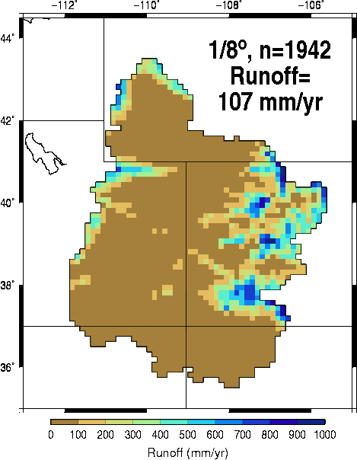
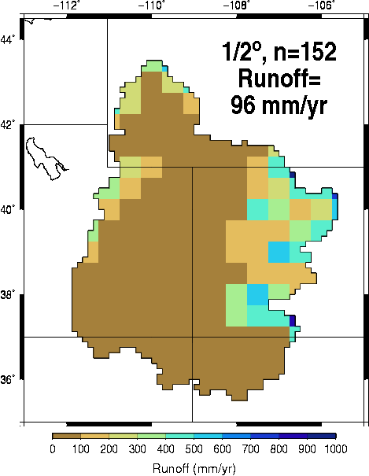
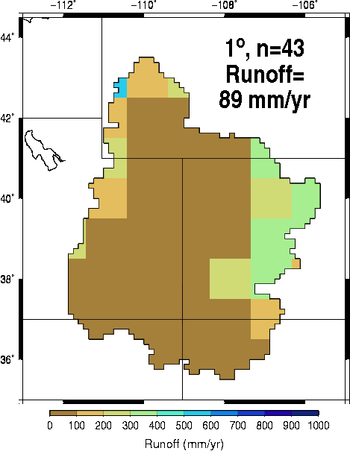
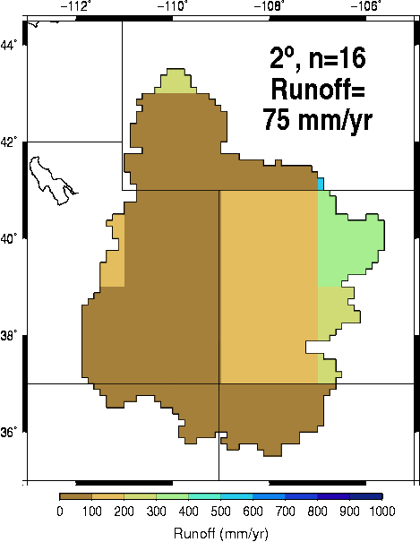
0 100 200 300 400 500 600 700 800 900 1000
Runoff (mm/year)
2) Spatial scale and topographic dependence of climate change projections
Figure from Vano et al., BAMS, in review.

Slide 30
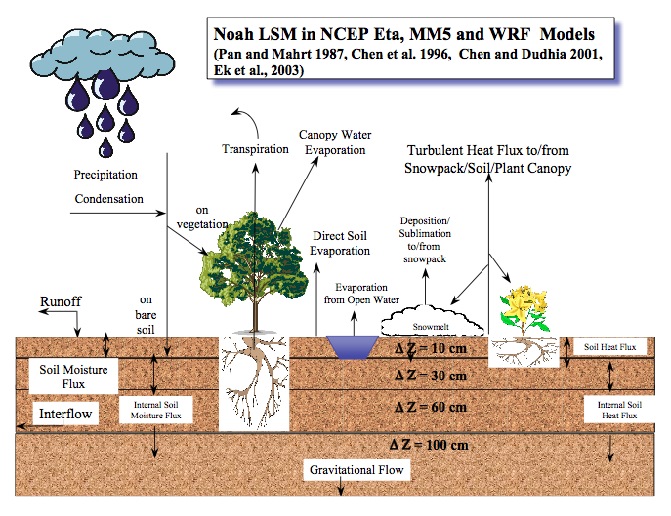
3) Land surface representations
GFDL GCM Hydrologic Component
Grid-based simulations of land-surface processes using principles of energy and water balance
Daily timesteps with some sub-daily processes
Forcing data: precipitation, temperature, specific humidity, wind speed, air pressure, and surface incident shortwave and longwave
Interested in those applied at regional to global scales
Diverse heritages and many more than those pictured above

Slide 31
3) Land surface representations
Land Surface Representations
Land Surface Representations
Q _{ref+1%} - Q_{ref}
Q _{ref+0.1°C} - Q_{ref}
Precipitation
Elasticity
=
Temperature
Sensitivity
=
Q_{ref}
Q_{ref}
1%
0.1 °C
Figure from Vano et al., BAMS, in review

Slide 32
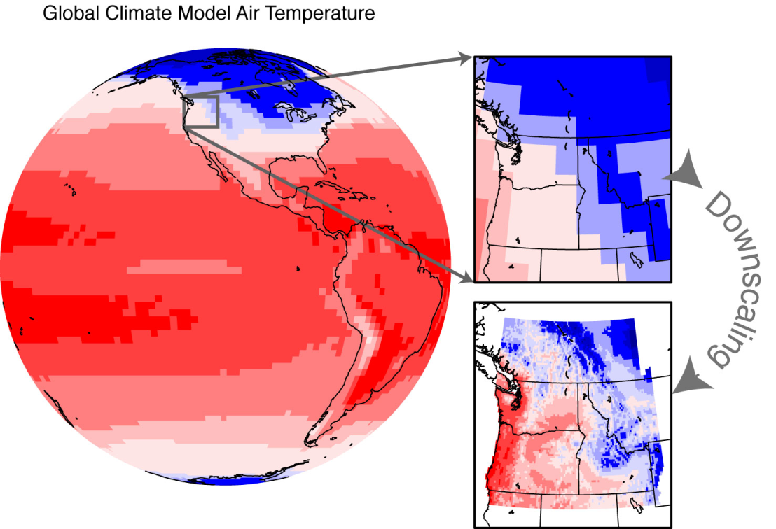
4) Statistical downscaling methods
How do we translate global info into regional water management?
Figure courtesy of Phil Mote

Slide 33
4) Statistical downscaling methods
Comparison of BCSD downscaling from Christensen and Lettenmaier (2007) with a delta method downscaling approach for Lees Ferry in the 2040-2069 future period for the A2 where, on average, the BCSD approach has a decline of 7% whereas with the delta method, declines are 13%.
Figure from Vano et al., BAMS, in review

Slide 34
4. Understanding hydrologic sensitivities to climate change – the Colorado River basin as a case study

Slide 35
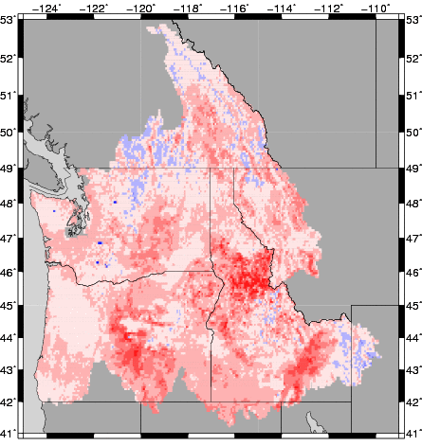
I. Multi-model
approach
II. Hydrologic sensitivities approach
Global Climate
Models
Global Climate
Models
downscaling,
bias correcting
maps of sensitivities to temp & precip change
Hydrology
Models
stream routing,
bias correcting
Water Supply
Operations Models
Changes in Central
Tendencies
Climate Impact
Climate Impact

Slide 36
Climate
Scenarios
Performance
Measures
Downscaling
Global climate simulations, next ~100 yrs
Delta
Precip,
Temp
Reliability
of System
Objectives
Water
Management
Model
Hydrologic
Model (VIC)
DamReleases,
Regulated
Streamflow
Natural
Streamflow

Slide 37
Methodology
Land-surface Hydrologic Models
Measures
Catchment LSM
Community Land
Model 3.5 (CLM)
Noah 2.7 LSM
Noah 2.8 LSM
Sacramento (Sac)
Variable Infiltration
Capacity 4.0.6 (VIC)
Q _{ref+1%} - Q_{ref}
P
elasticity
=
Q_{ref}
1%
Q _{ref+0.1} - Q_{ref}
T
sensitivity
=
Q_{ref}
0.1°C
P &T
interactions
Spatially…

Slide 38
Land-surface Hydrologic Models
Grid-based simulations of land-surface processes using principles of energy and water balance
Selected LSMs that have been widely applied at regional to global scales
Diverse heritages:
Sac and VIC developed specifically for streamflow simulation purposes
Noah, Catchment, CLM developed for use in global climate models
Model versions used as in previous studies, did not calibrate for this study

Slide 39
Land-surface Hydrologic Models
1/8 degree latitude-longitude spatial resolution
Similar forcing data: precipitation, temperature, specific humidity, wind speed, air pressure, and surface incident shortwave and longwave
Daily timesteps with some sub-daily processes
Results reported for water years 1975-2005

Slide 40
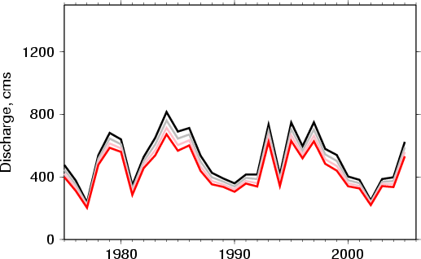
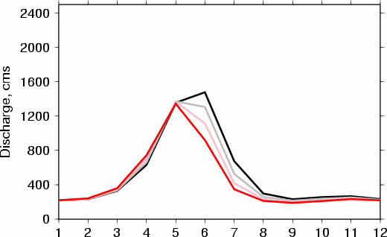
Delta method climate forcings
Applied uniform perturbations in precipitation or temperature at every timestep in historic record
Precipitation change: related magnitude change in streamflow
Temp increases: streamflow decreases annually, primarily because decreases flow in spring/summer
Common across models? Where are these changes occurring? Specific land-surface characteristics? Thresholds?
VIC
Historical
1 ºC
2 ºC
3 ºC

Slide 41
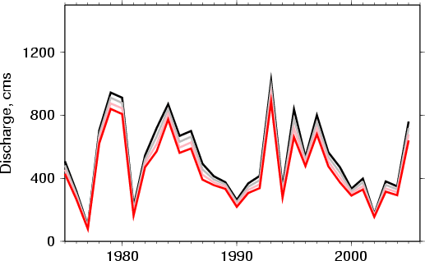
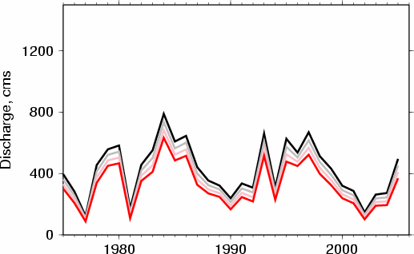
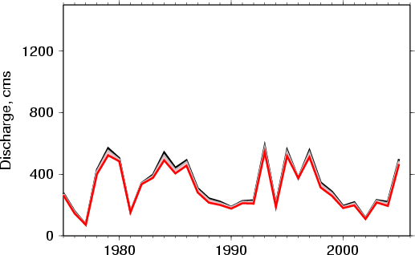
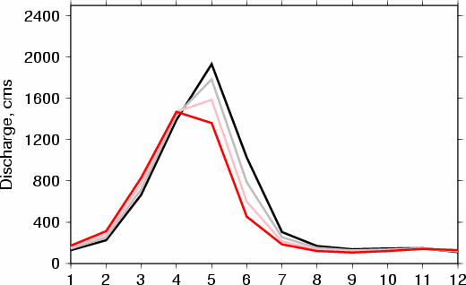
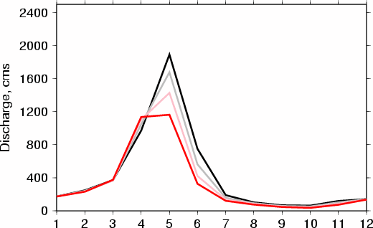
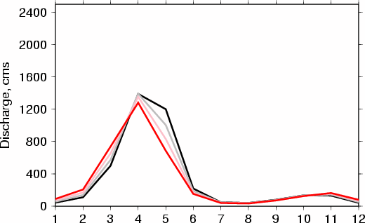
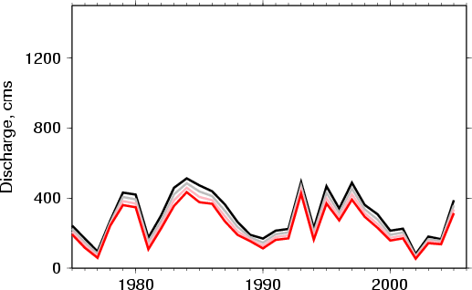
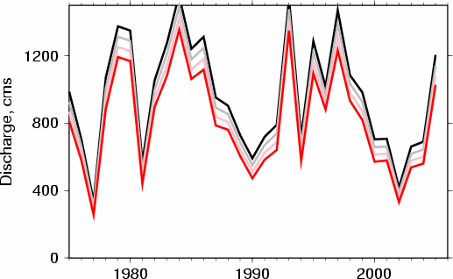
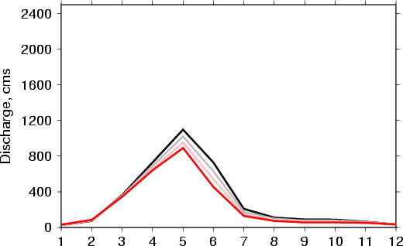
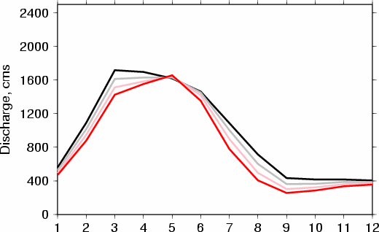
Delta method climate forcings
Discharge, cms
VIC
Sac
CLM
Catchment
Historical
1 ºC
2 ºC
3 ºC
Discharge, cms
At Lees Ferry, flows differ between models, but models appear to have similar patterns in temp sensitivity
Noah 2.7
Noah 2.8

Slide 42
Delta method climate forcings
Discharge, cms
VIC
Sac
CLM
Catchment
Historical
1 ºC
2 ºC
3 ºC
Discharge, cms
At Lees Ferry, flows differ between models, but models appear to have similar patterns in temp sensitivity
Noah 2.7
Noah 2.8

Slide 43
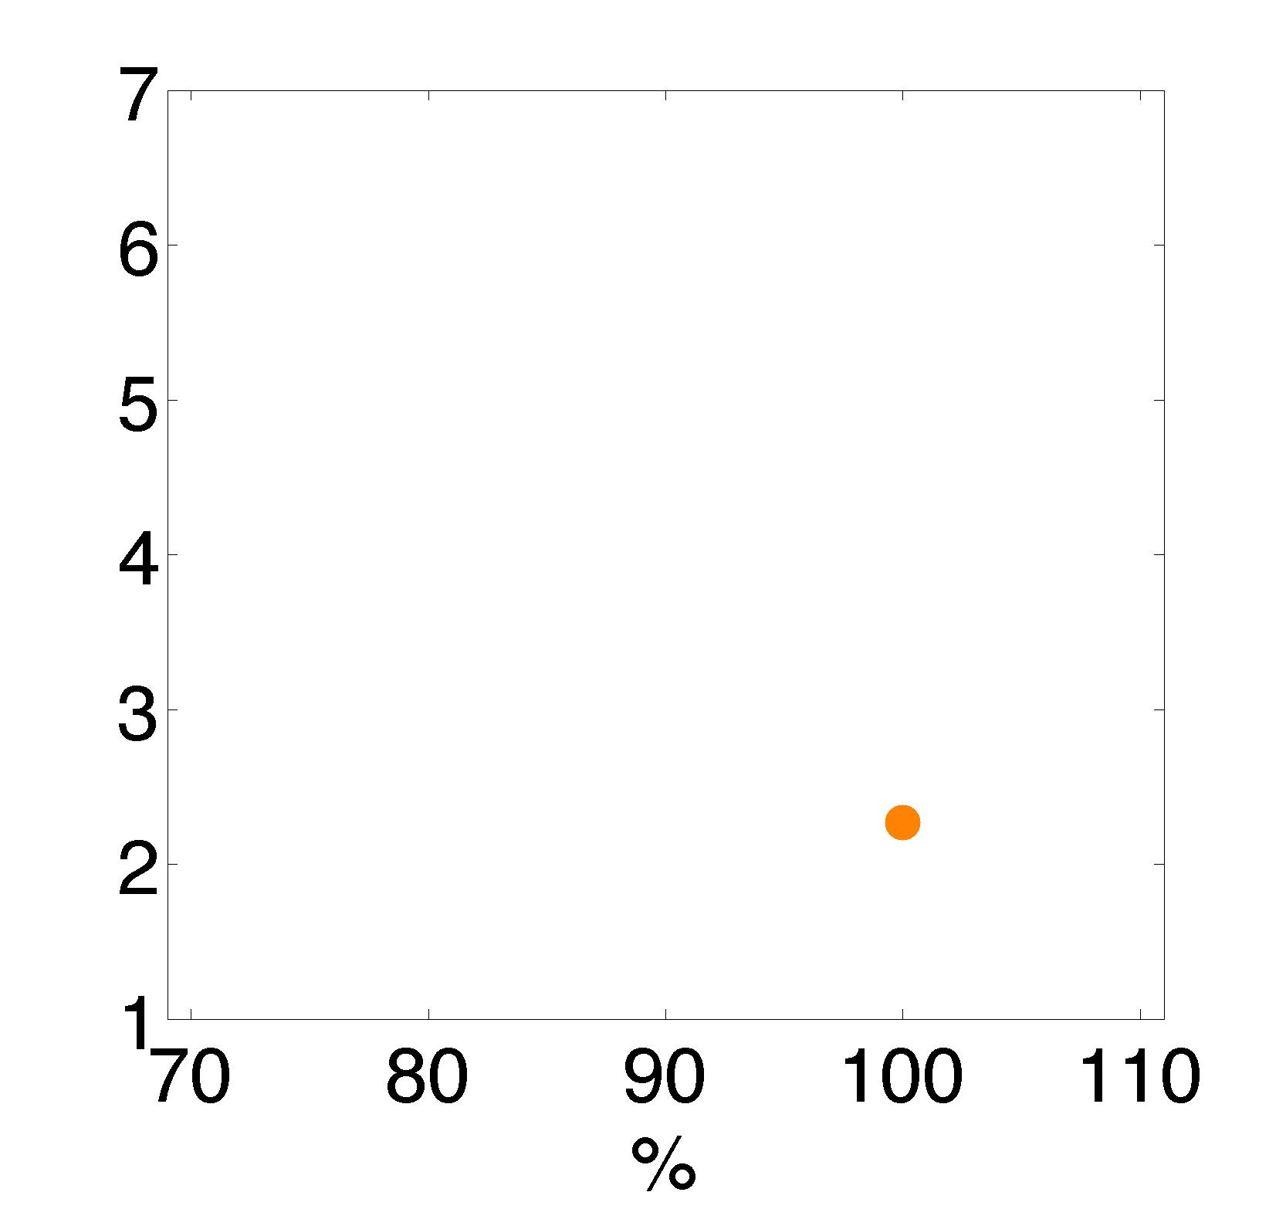
Precipitation Elasticities
percent change in flow per percent increase in precipitation
historic flows at Lees Ferry
precip elast, Lees Ferry
Q _{ref+1%} - Q_{ref}
P
elasticity
=
Q_{ref}
1%
reference precipitation (100% = historical)
observed
(non-parametric estimator)

Slide 44
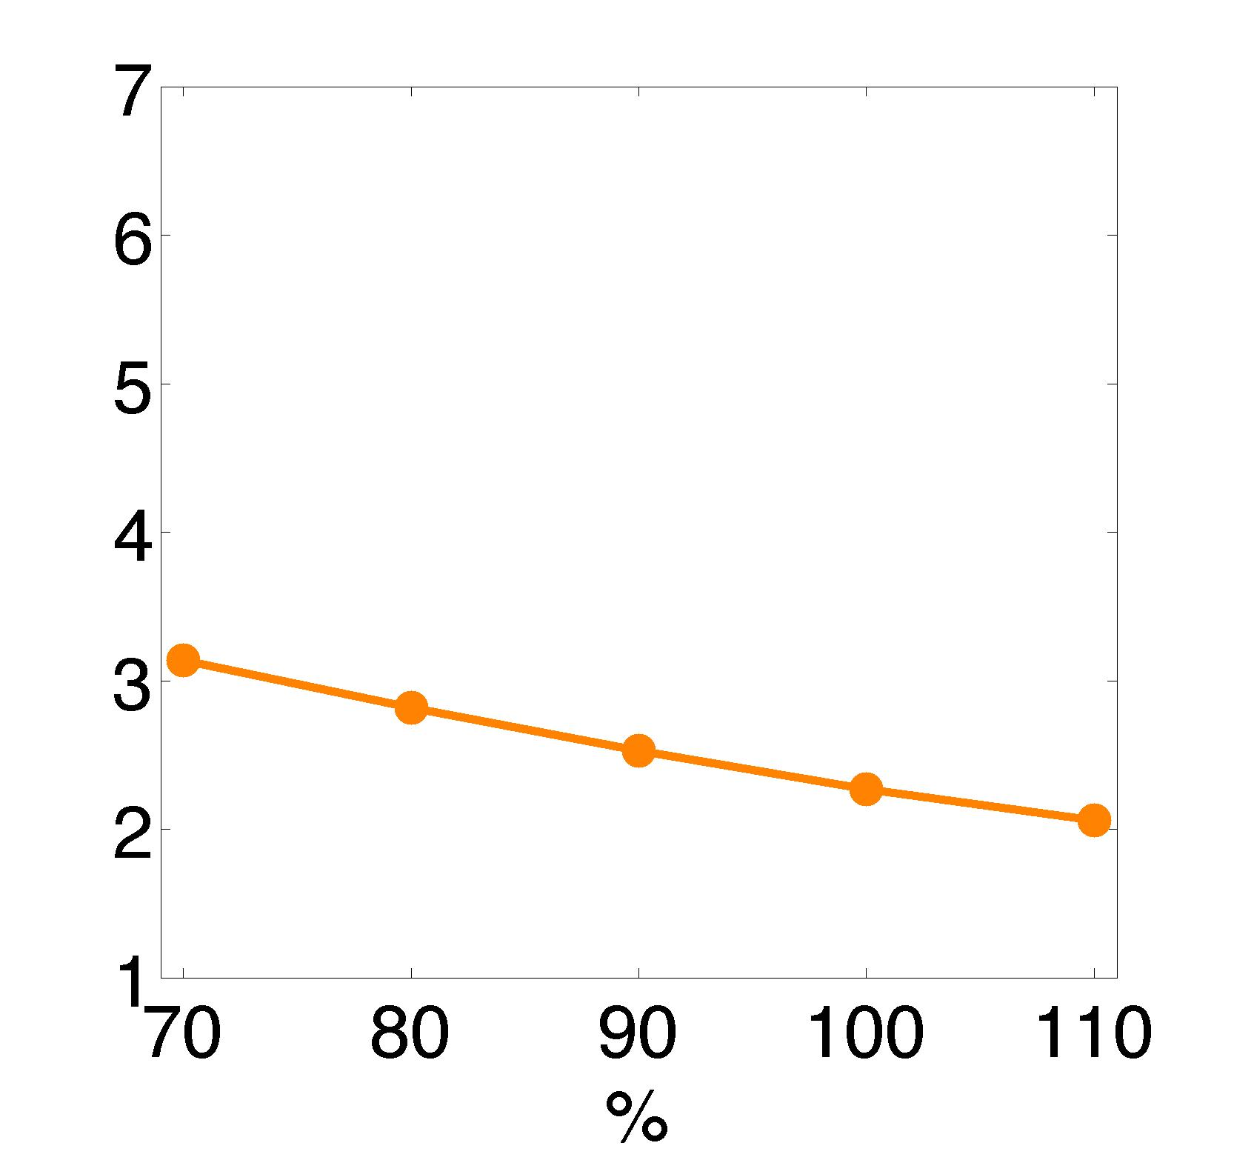
Precipitation Elasticities
percent change in flow per percent increase in precipitation
historic flows at Lees Ferry
precip elast, Lees Ferry
Q _{ref+1%} - Q_{ref}
P
elasticity
=
Q_{ref}
1%
reference precipitation (100% = historical)
observed
(non-parametric estimator)

Slide 45
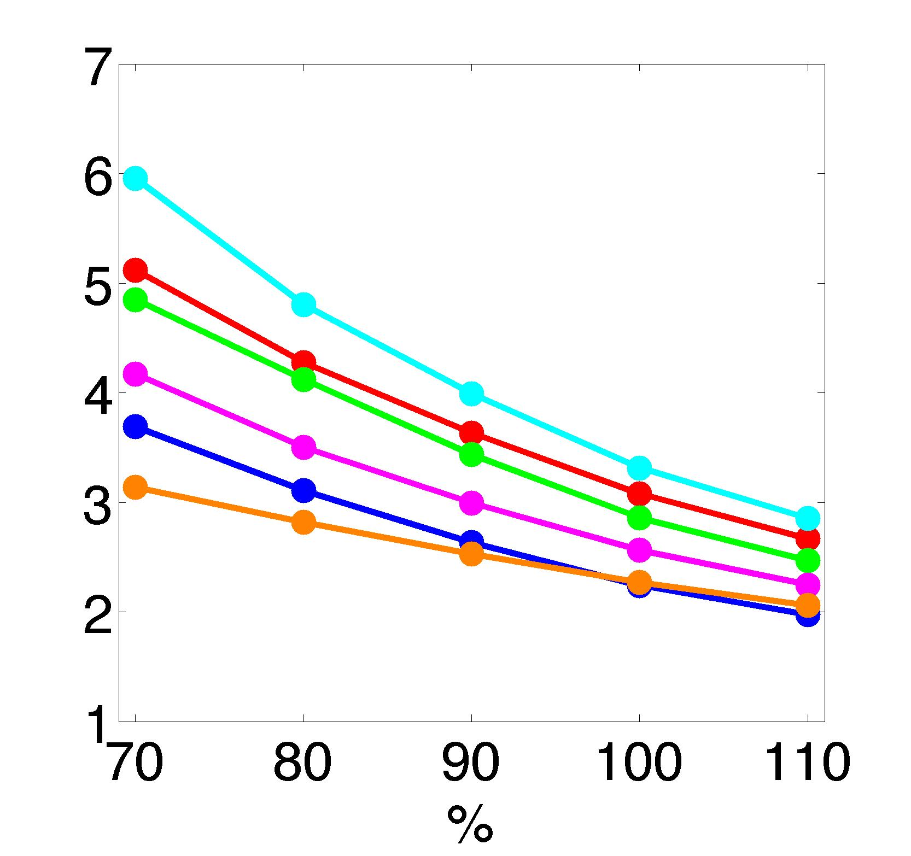
Precipitation Elasticities
percent change in flow per percent increase in precipitation
historic flows at Lees Ferry
precip elast, Lees Ferry
Q _{ref+1%} - Q_{ref}
P
elasticity
=
Q_{ref}
1%
reference precipitation (100% = historical)
observed
(non-parametric estimator)

Slide 46
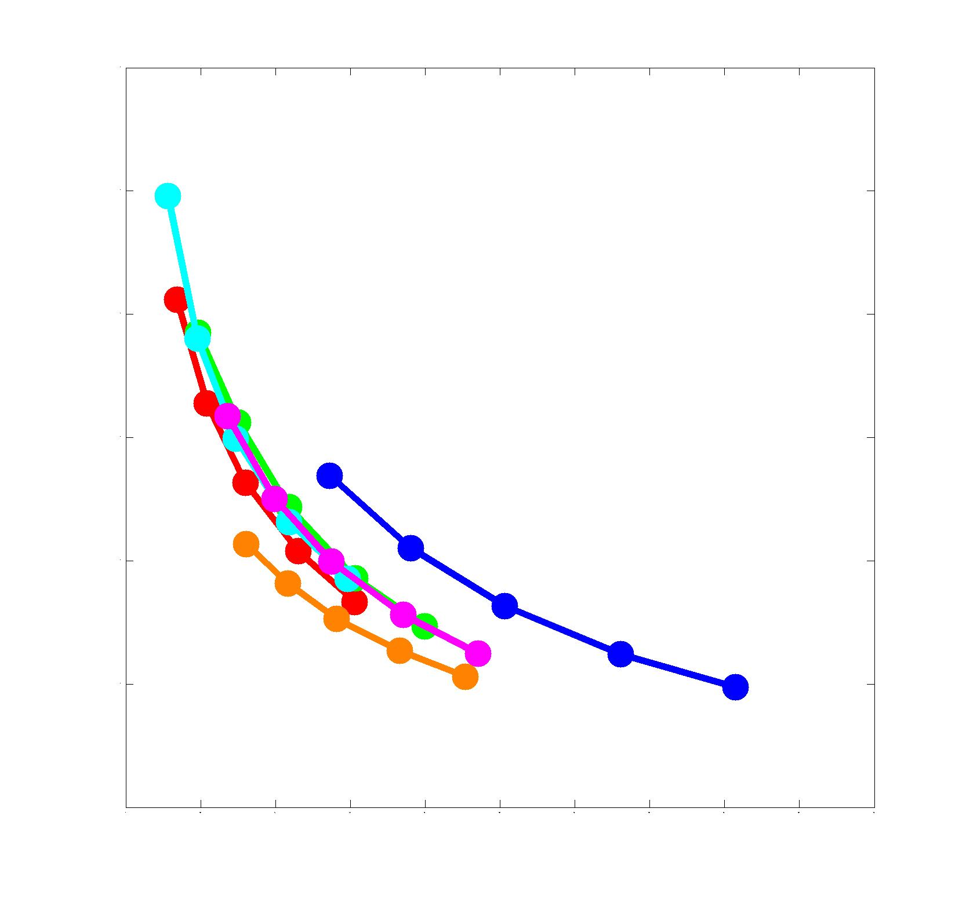
Precipitation Elasticities
percent change in flow per percent increase in precipitation
historic flows at Lees Ferry
precip elast, Lees Ferry
Q _{ref+1%} - Q_{ref}
P
elasticity
=
Q_{ref}
1%
0 200 400 600 800 1000 1200 1400
average runoff (cms)

Slide 47
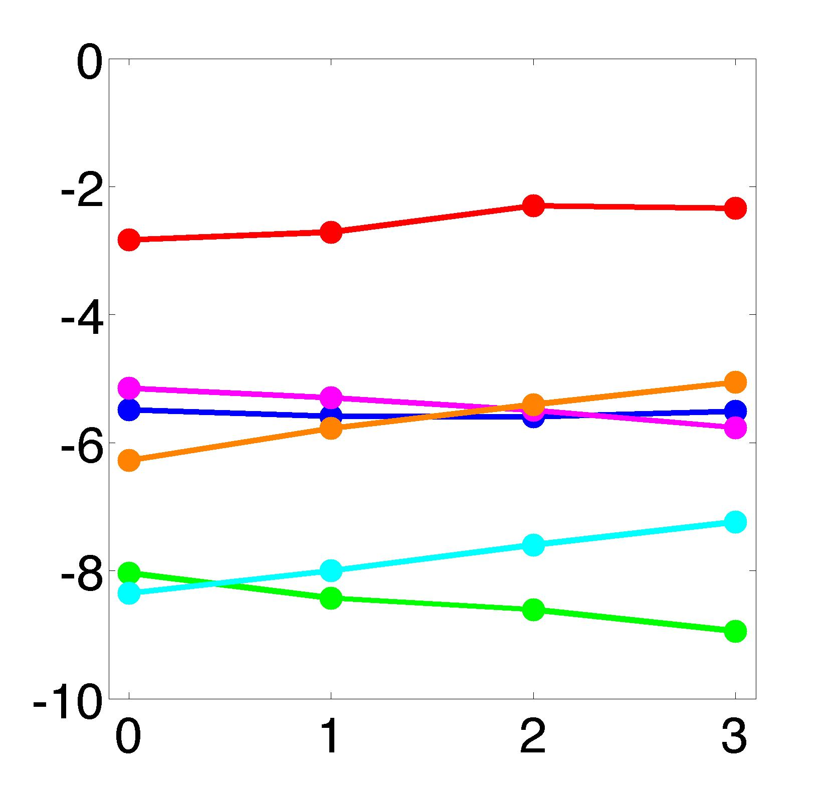
Temperature Sensitivity
percent change in flow per °C temperature increase
temp sens (%), Lees Ferry
(Tmin & Tmax)
reference temp in °C (historical = 0)
T
Sensitivity
(Tmin&Tmax)
Q _{ref+0.1} - Q_{ref}
=
Q_{ref}
0.1 ° C

Slide 48
Precipitation & Temperature
Q_{1%prcp}
?
Q_{1°C & 1%prcp}
Q _{base}
Q_{1°C}
?
Q _{base} + (Q_{1%prcp}- Q_{base}) +(Q_{1°C} - Q_{base}) = Q_{1°C & 1%prcp}
estimated
actual sim
rearrange to more easily compare small differences:
?
(Q_{1%prcp}- Q_{base}) + (Q_{1°C} - Q_{base}) = Q_{1°C & 1%prcp} – Q_{base}

Slide 49
Projected changes in 21st C Colorado River Streamflow, full simulation vs sensitivity-based reconstruction

Slide 50
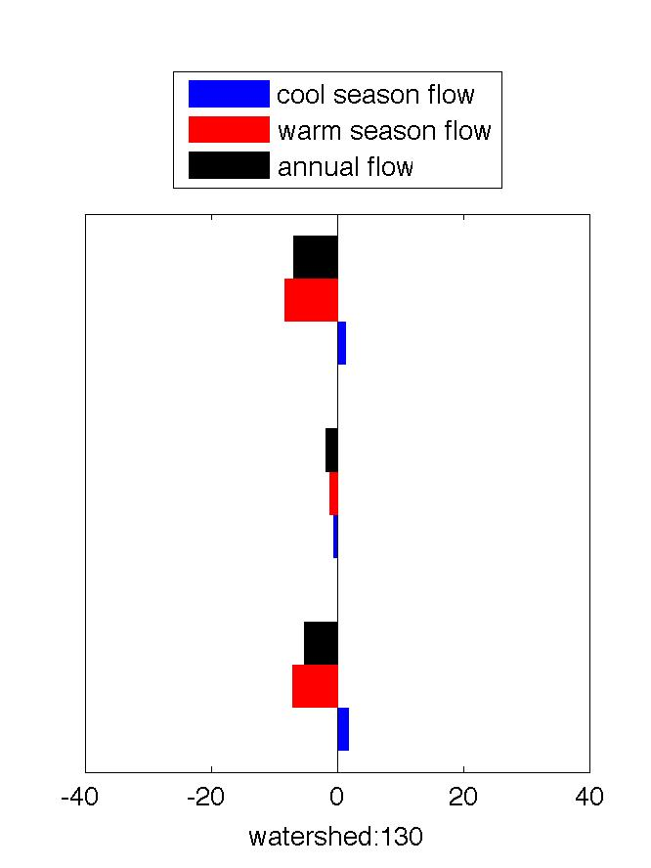
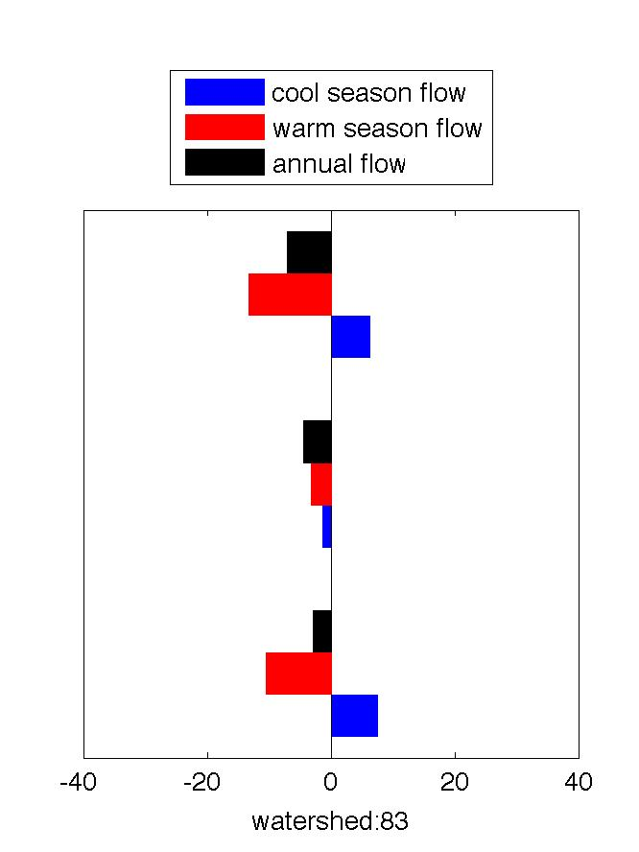
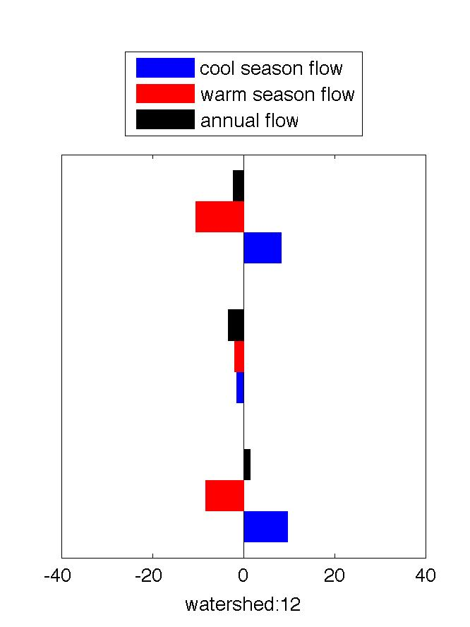
Categories of Sub-basin Responses to changes in annual flow (VIC)
★
LEGEND
Watershed units
More sensitive to cool season warming
More sensitive to warm season warming
Cool season warming positive
Example watersheds (below)
★
★
★
Example watersheds:
Warm applied year-round
Responses in:
Warming applied in warm season only
Warming applied in cool season only
Streamflow change (%)
Notes:
Sub-basins have a diversity of hydroclimatology, vegetation, soils, and topography
Large seasonal shifts
1)More sensitive to cool season warming: Annual streamflow changes more with cool season warming than with warm season warming. 83 of the 226 sub-basins (36%) have this characteristic which is also seen in the South Sierra.
(2) More sensitive to warm season warming: Annual streamflow changes more with warm season warming than with cool season warming. This characteristic is seen in basin-wide responses in the Colorado, Columbia, and North Sierra. Including the special case below, this response is most common (in 64% of all sub-basins).
(3) Cool season warming positive: High elevation areas where increases in cool season flows are greater than decreases in warm season flow resulting in net increases in flows if warming only occurs in the cool season. This occurs in 14% of sub-basins.
Even though the Columbia as a whole has substantially greater sensitivity to warm as contrasted with cool season warming, 27% of the 151 sub-basins upstream of the Dalles show the reverse behavior (dominant sensitivity to cool season warming), and this pattern pertains to many of the coastal drainages downstream of the Dalles (especially in Oregon) as well.

Slide 51
Monthly Temperature Sensitivities
(Yakima River at Parker)
Annual T Sens
T Sens in a given month (from all months)
(2)
Annual contribution to T Sens from a particular 3-month warming
Warm applied year-round
Warming applied in warm season only
Warming applied in cool season only
Streamflow change (%)

Slide 52
5. Water management implications

Slide 53
Major rivers of the U.S
Figure from Steve Burges, CEE 576, Physical Hydrology, Fall 2007

Slide 54
Natural Flow at Lee Ferry, AZ
allocated 20.3 BCM
Currently used 16.3 BCM

Slide 56
Total Basin Storage (from Christensen et al., 2004)

Slide 57
Annual Releases to the Lower Basin (from Christensen et al., 2004)
target release

Slide 58
Annual Releases to Mexico (from Christensen et al., 2004)
target release

Slide 59
Annual Hydropower Production (from Christensen et al., 2004)

Slide 60
6. Preview of IPCC AR5 climate simulations with respect to Colorado River streamflows

Slide 61
Sensitivity based estimates of VIC AR5 Colorado River runoff changes, RCP 26

Slide 62
Sensitivity based estimates of VIC AR5 Colorado River runoff changes, RCP 45

Slide 63
Sensitivity based estimates of VIC AR5 Colorado River runoff changes, RCP 60

Slide 64
Sensitivity based estimates of VIC AR5 Colorado River runoff changes, RCP 85

Slide 65
Concluding thoughts
There is a disconnect between the climate science and water management communities that is only now beginning to break down. They are aware of climate projections, and may be using them informally, but formally, most decisions are still based on analysis of historical observations.
There is a need to update and extend the work in planning under uncertainty (e.g., the Harvard Water Program of the 1960s) for nonstationary environments.
Dealing with (lack of) consistency in climate projections (periodic updates) is one key aspect of the problem.

