Slide 1
Career Fair Prep Workshop
Jennifer Jordan
Jackson School of Geosciences Career Center
Notes:
Hello! Welcome to the Career Fair Prep presentation. My name is Jennifer Jordan and I am here to talk to you about the in’s and out’s of career fairs. The main points being making a good first impression by having knowledge of the company and an idea of who you want to speak to first.
Our career fair is small compared to other campus fairs so it is possible you get to speak to everyone - especially if you are exploring careers! However, I encourage you to think of your top 5 employers and go from there. You can have a plan or not – it’s up to you.
We have a wonderful and diverse employer turnout so take advantage of this opportunity to connect with multiple professionals.

Slide 2
Overview
The plan
Introductions & Expectations
What to do:
Before the fair
During the fair
After the fair
Notes:
I would like to start by getting a sense of what you are all hoping to get out of this presentation. Is anyone willing to share what they would like to learn?
Great, thanks for sharing. I will try to incorporate all of your questions into the presentation. Also, I’d like for this to be interactive, so please speak up with questions as we go along. I’m also going to make this interactive, so that you can practice things like your handshake and introduction.
As an overview, we’ll be talking about what you should do between now and next Thursday, what to do during the fair as well as after.

Slide 3
Before the fair
Goals
How will you know the fair was successful?
Ideas
Network and make connections
Learn more about companies
Feel more prepared for interviews
Be considered as a candidate
Drop off your resume
Explore career options
Notes:
I’d like to start by talking about goals. You are all planning to attend the career fair for a reason, and I’m guessing those reasons vary quite a bit. Thinking in advance about your expectations will help you mentally prepare and make you feel like you have a defined purpose for going.
I’d like for you to think for a moment about this question: How will you know that the fair was successful? In other words, what needs to happen during the fair for you to feel satisfied? Is anyone willing to share their idea?
Here are some possible goals that I came up with. I’d like for you to write down whatever you come up as a goal. Great- so keep your goal in mind as we go along this presentation and use that as the context for everything we talk about.

Slide 4
Before the fair
How to prepare
Introduction
Handshake
Resume
Knowledge of Company
Questions
Appearance
Resume
Handshake
Introduction
Knowledge of Company
Appearance
Questions
Notes:
Now that we’ve talked about why you’re going to the fair, let’s go through each piece of preparation. I like to imagine a toolbox- all of these things are your tools. By thinking through each of these pieces before the career fair, you will feel more prepared and confident.

Slide 5
Before the fair
Research companies
Find out who will be at the fair
Determine companies of greatest interest
Look at descriptions on Handshake
Determine the jobs you’ll apply for
Learn about the companies
Knowledge of Company
Questions
Appearance
Resume
Handshake
Introduction
Notes:
The first tool, so to speak, is to figure out who you want to talk to at the fair and gain knowledge of the companies. On your sheet I’ve added the list of companies that will be at the fair.
With what you know about these companies right now, I’d like for you to circle about 5 companies that you are really interested in. If there are any companies that you are not interested in for any reason, feel free to cross those out. Also, if there are companies that you know nothing about, put a ? Next to the company name. That will remind you to do a little research on that company before the fair.
Going through this list is the first step. You can refine this list over the next week by looking at the job descriptions on GeoSource and identifying the companies that have positions you are qualified for. Prioritize the companies, if possible.

Slide 6
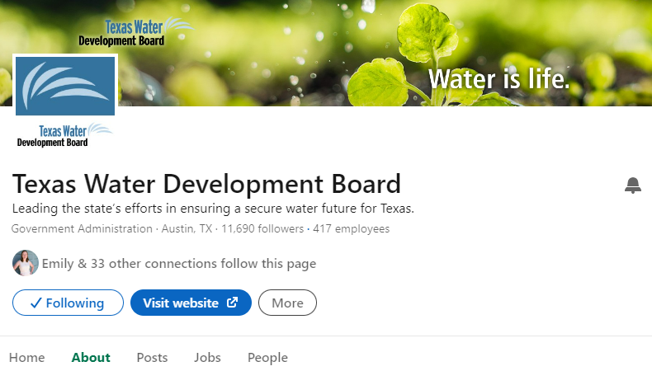
Before the fair
Research companies
Website
LinkedIn
Knowledge of Company
Questions
Appearance
Resume
Handshake
Introduction
Notes:
Once you know the companies that you are interested in, you should do some research on the companies. You don’t want to approach employers at the career fair and ask super simple questions that could easily be found on the website. You should have an idea of where they are located, what their main operations are, etc. You can obviously go to a company’s website to do research, but you can also use Linkedin.
How many of you have linkedin? Linkedin is wonderful for company research. I’ll show you an example w/ TWDB. GO TO PAGE. Go over the main sections of the site and highlight ‘how you’re connected’ and the services pages.

Slide 7
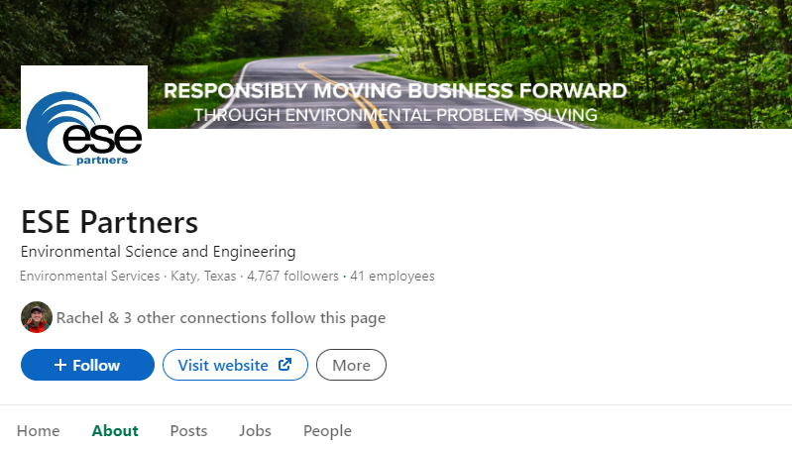
Before the fair
Research companies
Website
LinkedIn
Knowledge of Company
Questions
Appearance
Resume
Handshake
Introduction
Notes:
Once you know the companies that you are interested in, you should do some research on the companies. You don’t want to approach employers at the career fair and ask super simple questions that could easily be found on the website. You should have an idea of where they are located, what their main operations are, etc. You can obviously go to a company’s website to do research, but you can also use Linkedin.
How many of you have linkedin? Linkedin is wonderful for company research. I’ll show you an example w/ TWDB. GO TO PAGE. Go over the main sections of the site and highlight ‘how you’re connected’ and the services pages.

Slide 8
Before the fair
Research companies
Website
LinkedIn
Knowledge of Company
Questions
Appearance
Resume
Handshake
Introduction
Notes:
Once you know the companies that you are interested in, you should do some research on the companies. You don’t want to approach employers at the career fair and ask super simple questions that could easily be found on the website. You should have an idea of where they are located, what their main operations are, etc. You can obviously go to a company’s website to do research, but you can also use Linkedin.
How many of you have linkedin? Linkedin is wonderful for company research. I’ll show you an example w/ TWDB. GO TO PAGE. Go over the main sections of the site and highlight ‘how you’re connected’ and the services pages.

Slide 9
Before the fair
Questions for the recruiters
What do you want to know?
Have questions ready for the recruiters
Ideas
What do you like about working for ________?
What additional skills or training would help me in this field?
What skills or work experience do you look for in a candidate?
What is the company culture at _______?
Knowledge of Company
Questions
Appearance
Resume
Handshake
Introduction
Notes:
While you are researching companies, think of some questions for the recruiters. Having questions will demonstrate your interest.
Now, keep in mind that you may not be able to ask all of your questions to each recruiter. If many students are waiting, you don’t want to hog the recruiter. However, having some questions in mind will help you feel prepared and give you some conversation starters to rely on.
I’ve included some general questions here. Take a few minutes and write down some questions that you may want to ask, or any that you like from this slide.

Slide 10
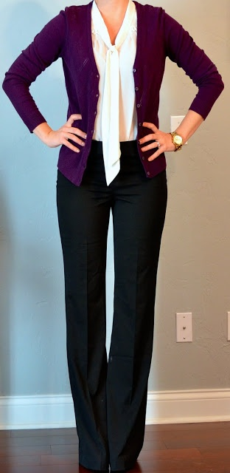
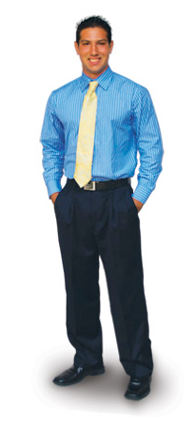
Before the fair
Appearance
2 Pieces (no jacket required)
Loafers, flats, boots, low heels
Top: Blouse, long sleeved button-up, tailored shirt, collard top
Bottom: Dress pants, knee length skirt or dress, khakis/slacks
Knowledge of Company
Questions
Appearance
Resume
Handshake
Introduction

Slide 11
Before the fair
Perfect your resume
Print resume on quality resume paper
2 page resumes:
Print double sided (if doesn’t bleed through)
Staple
Keep separate and add header to second page
Knowledge of Company
Questions
Appearance
Resume
Handshake
Introduction

Slide 12
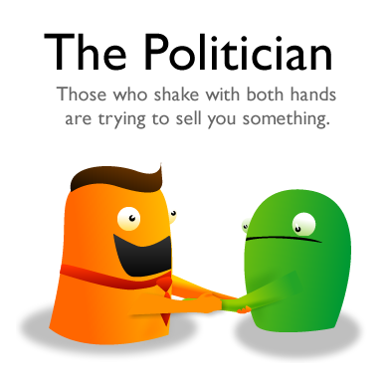
Beforehand…no pun intended Practice a good handshake
Source: http://theoatmeal.com/comics/handshakes

Slide 13
Before the fair
Practice your handshake
Practice
Knowledge of Company
Questions
Appearance
Resume
Handshake
Introduction
Notes:
Watch video from 45 sec-4 min
Let’s practice. I’d like everyone to get up and shake hand with a few people around the room.

Slide 14
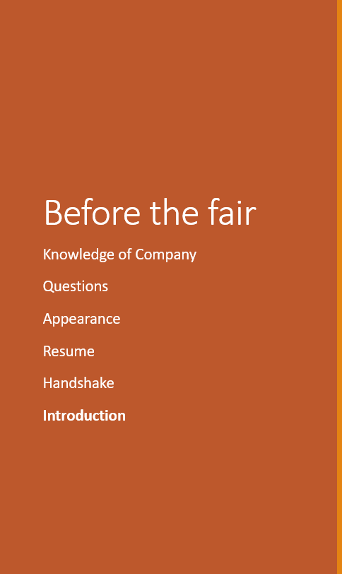
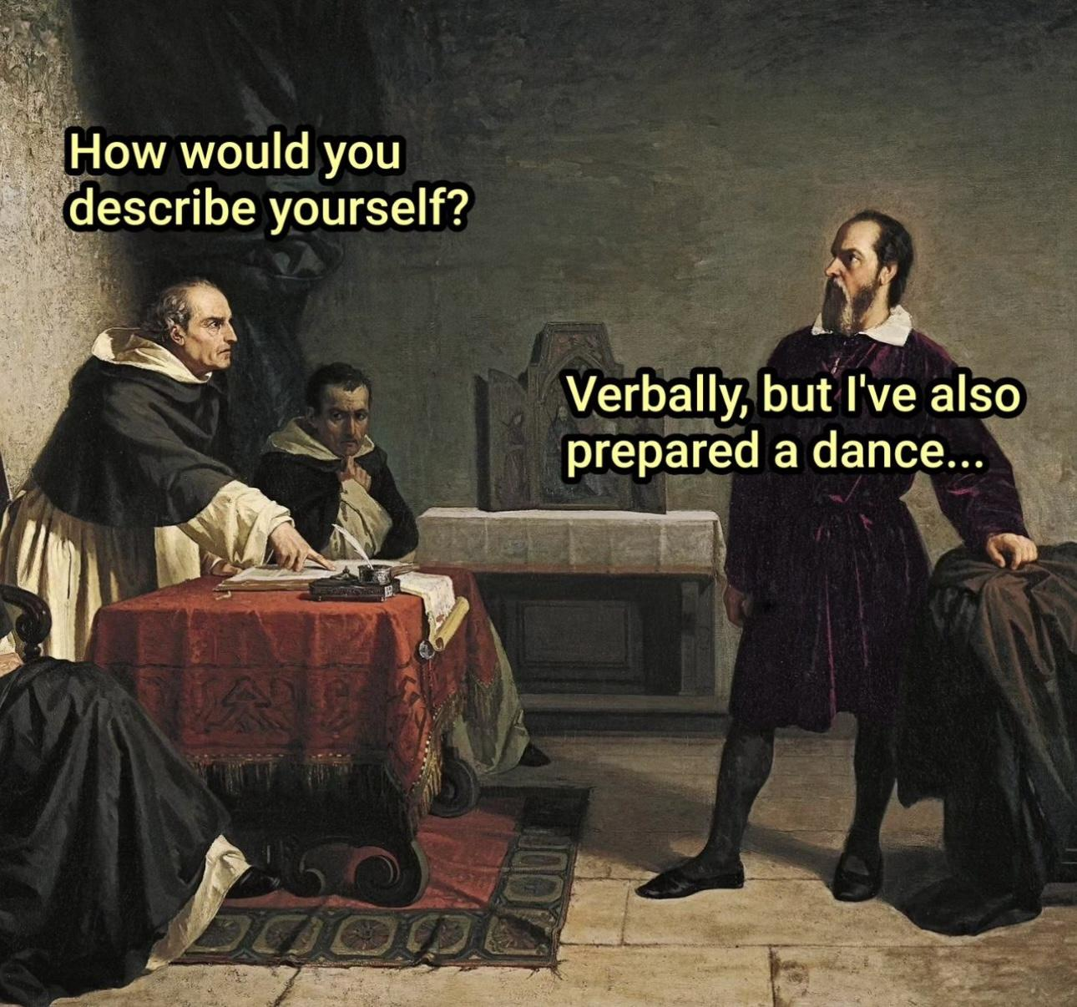

Slide 15
Before the fair
Practice your introduction
Elevator pitch
Example:
Hello, my name is ______________. I’m a _____________ at the Jackson School of Geosciences studying ___________________. I’m currently looking for a(n) ______________ position as a(n) ________________ for _______________. Can you tell me a little about _________?
Practice
Knowledge of Company
Questions
Appearance
Resume
Handshake
Introduction

Slide 16
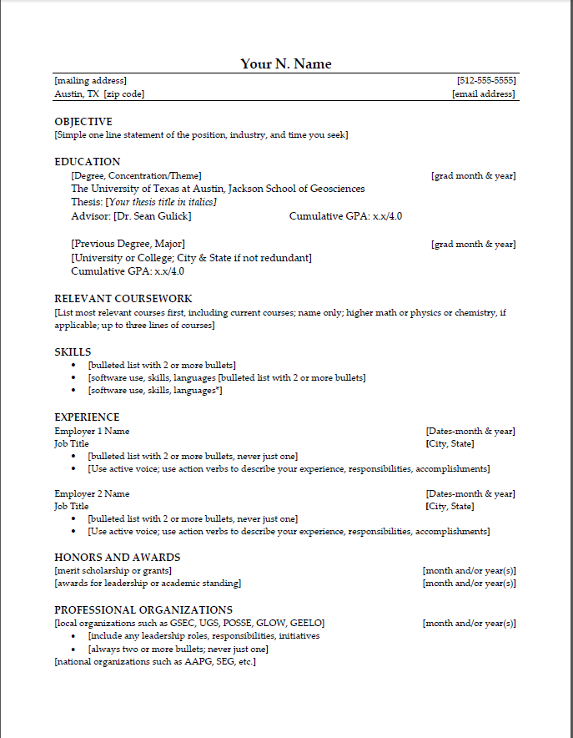
At the fair
What to bring
Backpack check-in
Padfolio
Resumes
What to bring
Strategy
Approach the booth
Close the conversation
Avoid the shopping spree
Take your headshot

Slide 17
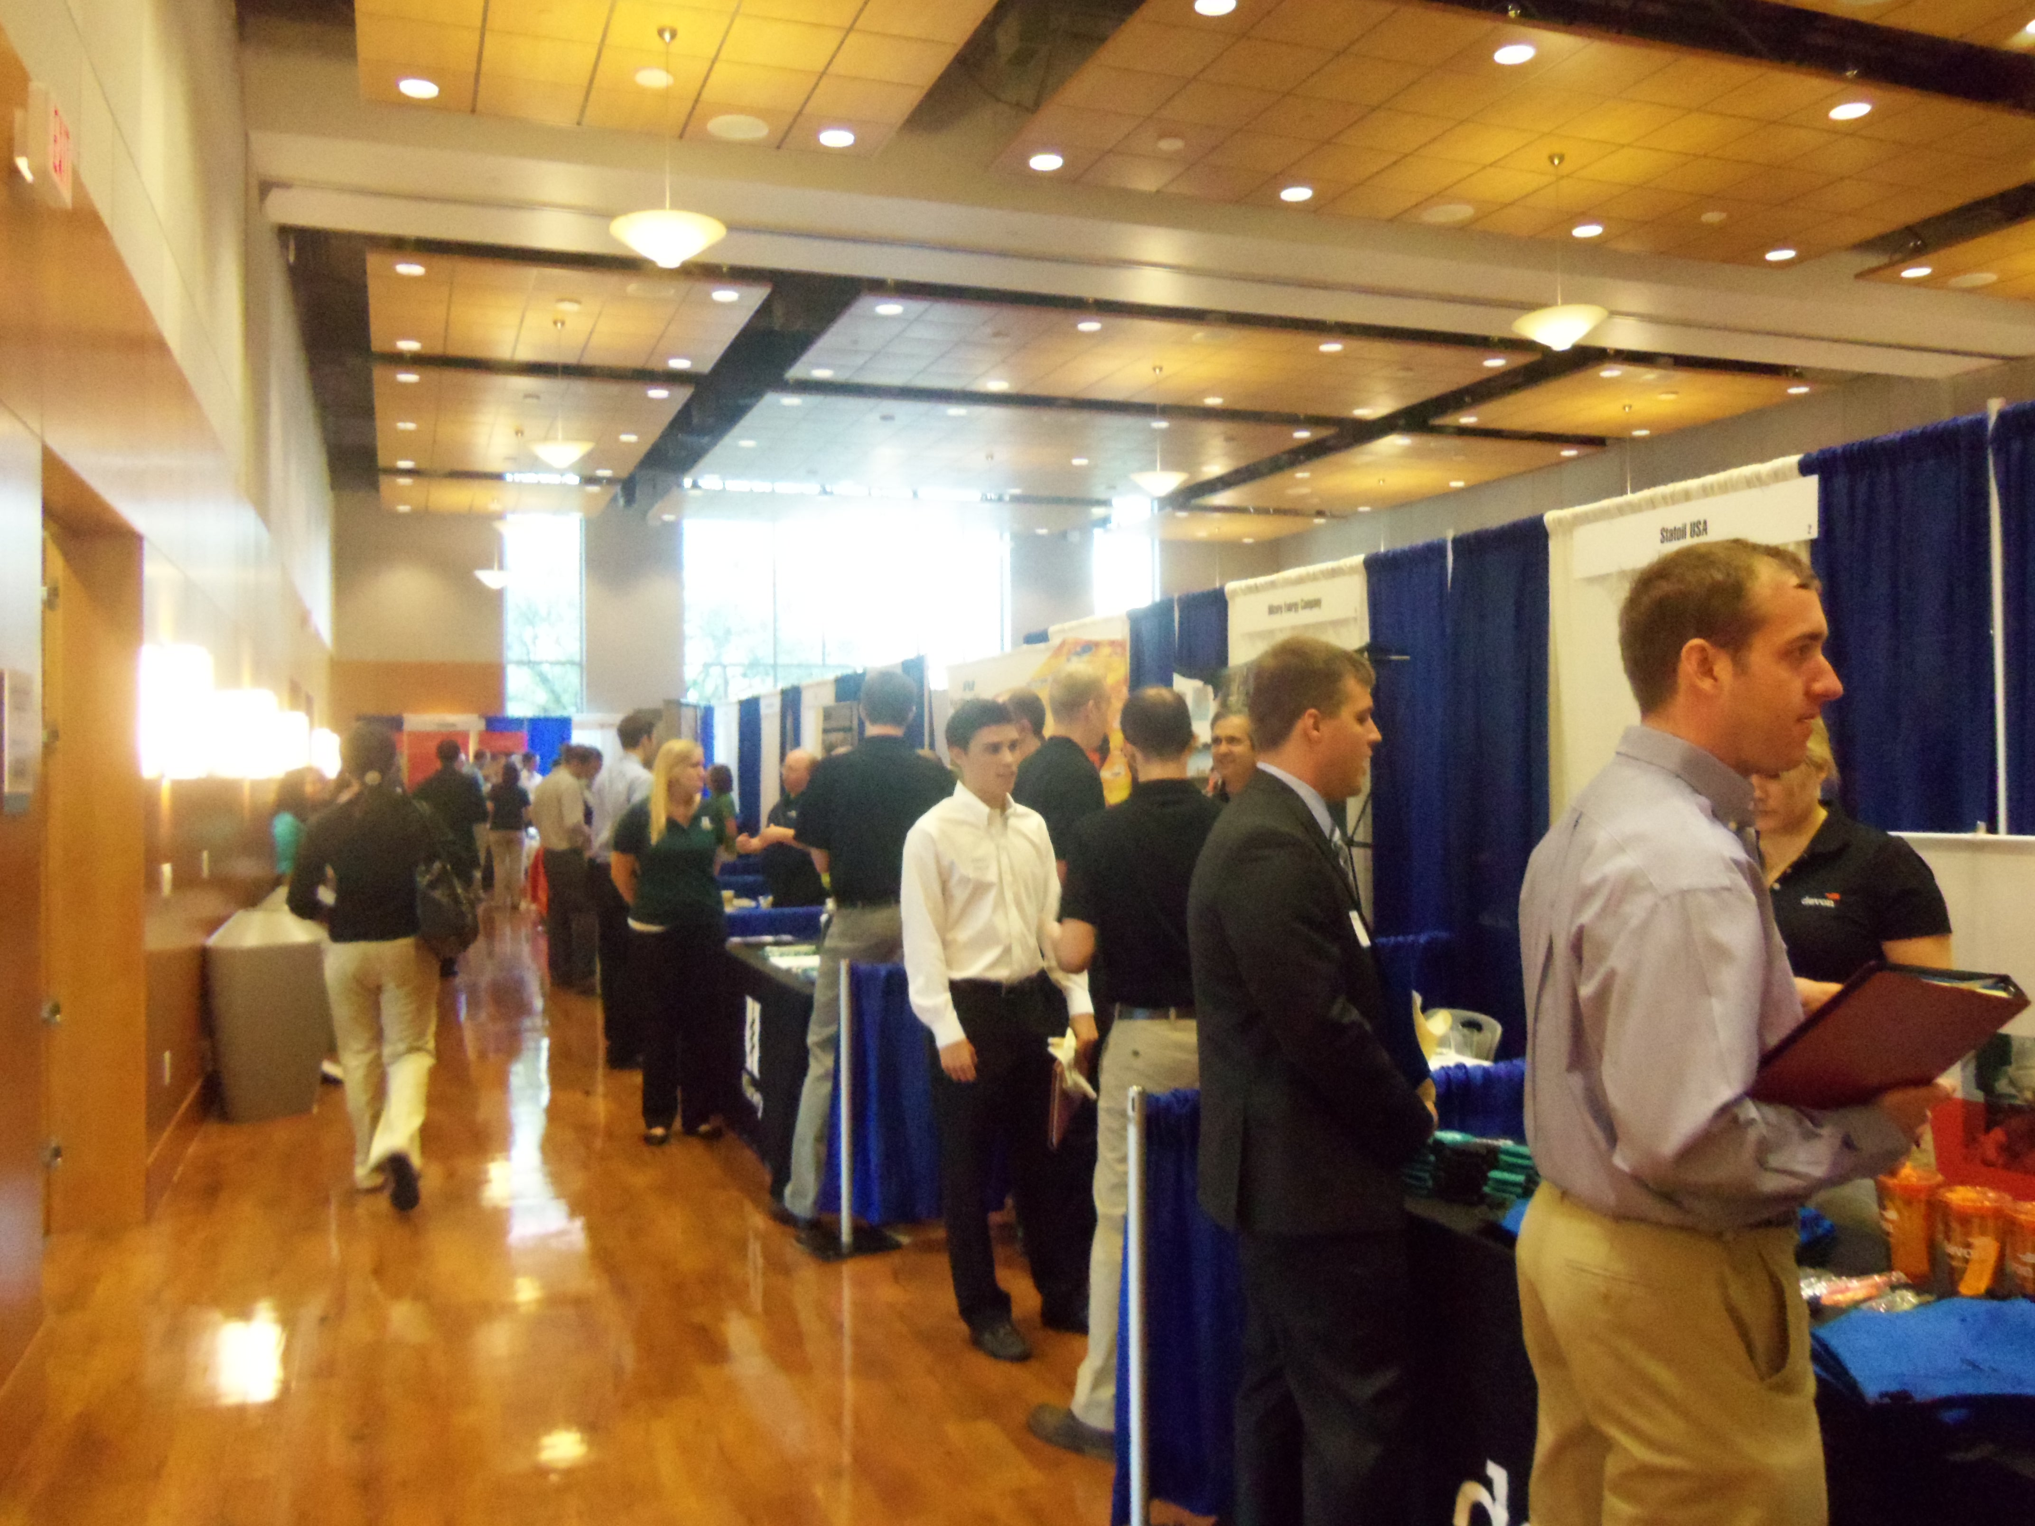
At the fair
Have a strategy
Decide where to start
Plan your time
What to bring
Strategy
Approach the booth
Close the conversation
Avoid the shopping spree
Take your headshot
Notes:
The last piece of this is deciding who you’ll talk to first. Now, if you prefer not to plan this out, that is totally fine. Some people like to have a strategy, however. Some might want to approach companies that they are not as interested in at first, as a way to warm up. Others might want to start out with their top companies. How you plan this part is totally up to you.

Slide 18
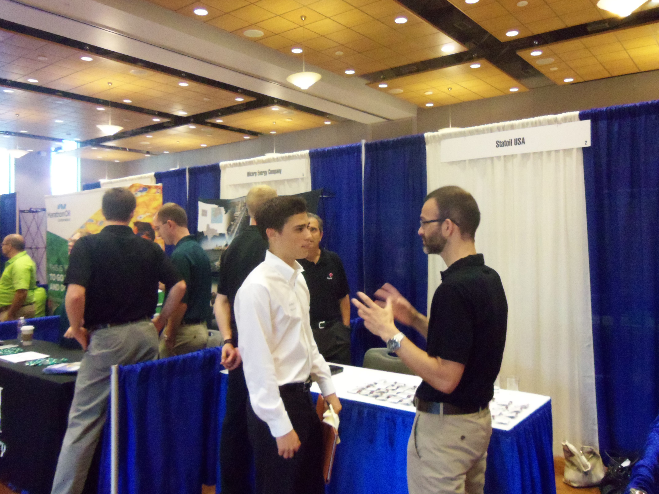
During the fair
Approach the booth
Smile
Offer handshake
Introduce yourself
Ask questions
What to bring
Strategy
Approach the booth
Close the conversation
Avoid the shopping spree
Take your headshot

Slide 19
During the fair
Close the conversation
Collect business cards
Ask for the next steps
What to bring
Strategy
Approach the booth
Close the conversation
Avoid the shopping spree
Take your headshot

Slide 20
During the fair
Avoid the shopping spree
What to bring
Strategy
Approach the booth
Close the conversation
Avoid the shopping spree
Take your headshot

Slide 21
During the fair
Take a headshot
Take your photo for LinkedIn! You’ll be all dressed up!
Ask someone to take your picture
What to bring
Strategy
Approach the booth
Close the conversation
Avoid the shopping spree
Take your headshot

Slide 22
After the fair
After the fair
Apply on Handshake or the company website
Follow-up with a thank you email
Prepare for interviews
Big Interview at https://utexas.biginterview.com/
Next Steps

Slide 23
Questions

