Slide 1
Career Fair Prep 2018
Jackson School of Geosciences
Career Services

Slide 2
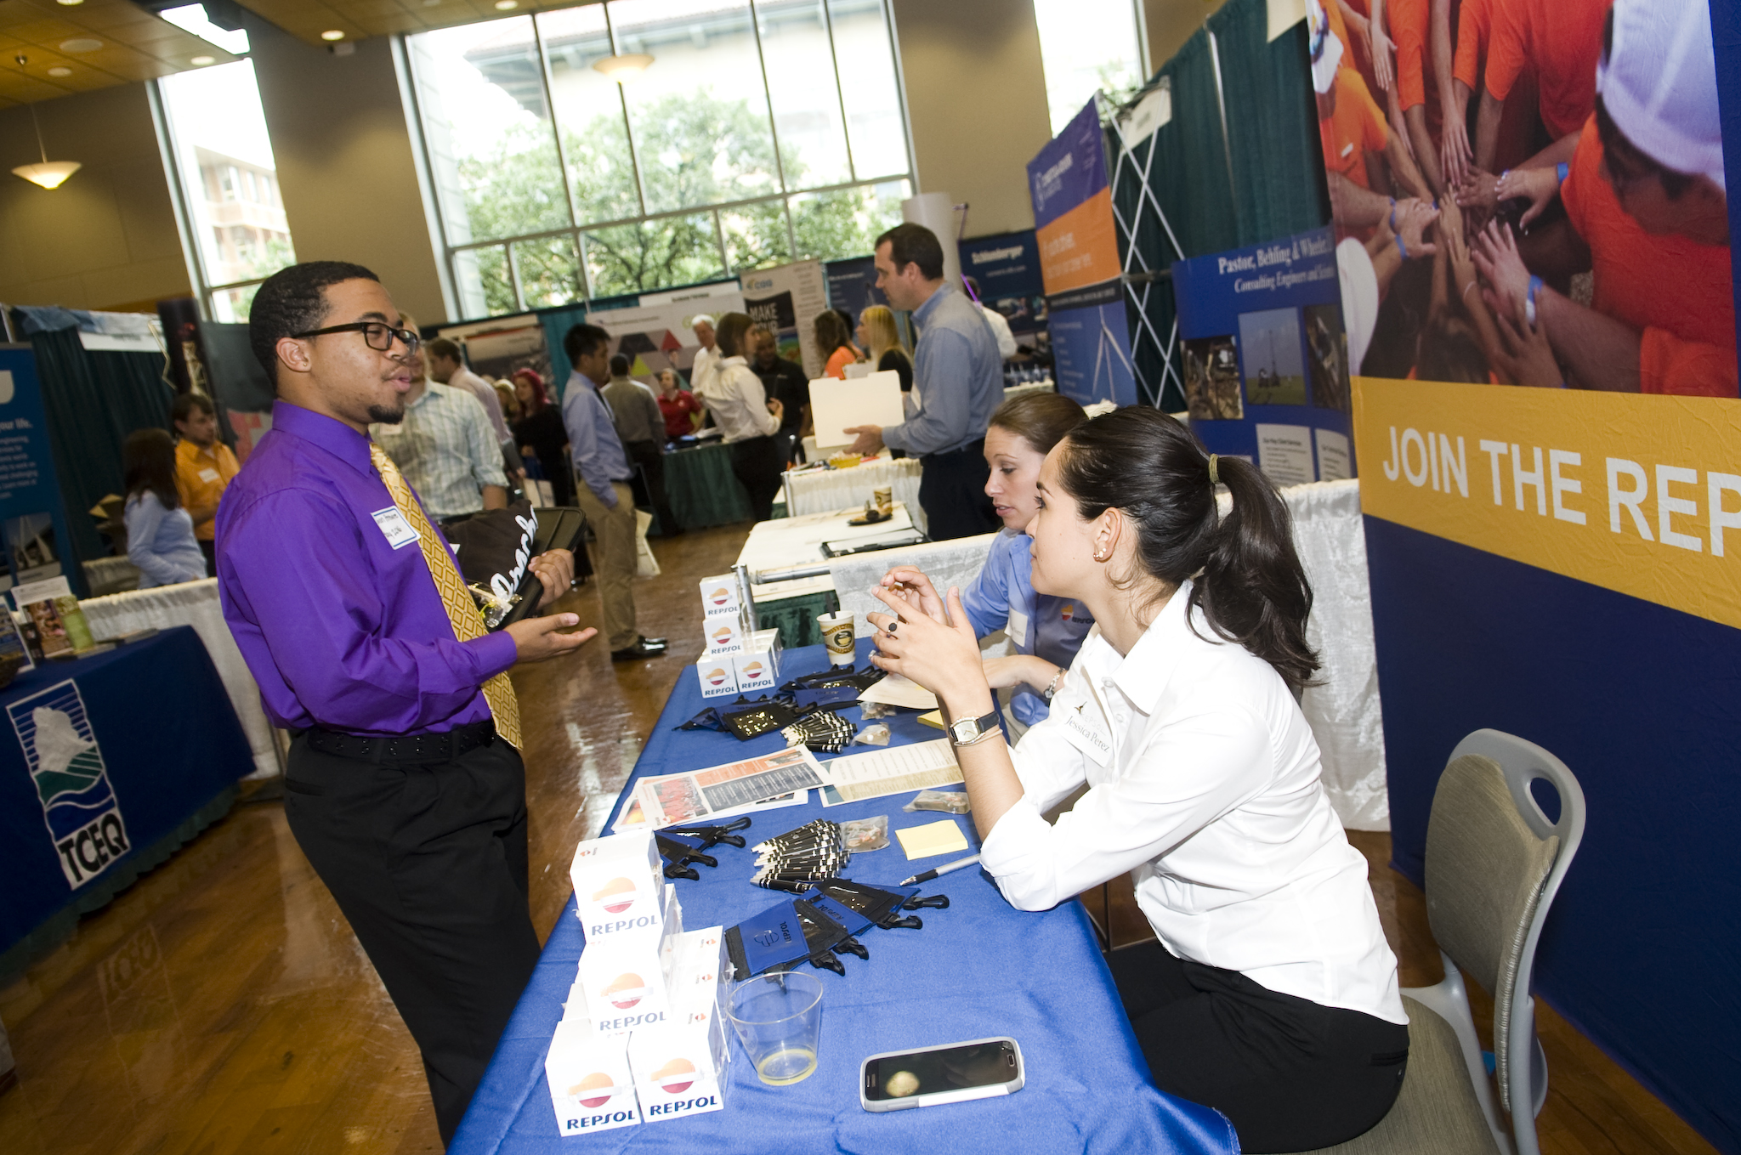
Workshop Outcomes
Have a goal for your time at the career fair
Know how to prepare between now and September 18th
Understand what to do while you’re at the fair
Know what to do after the fair

Slide 3
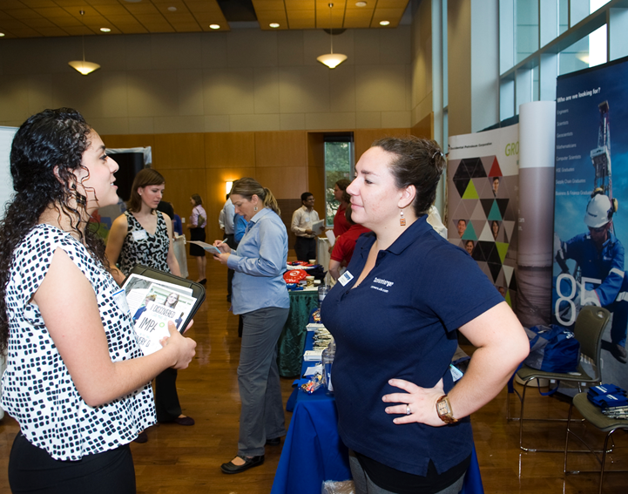
Defining your goal
Set goals
How will you know the fair was successful?
Possible goals
Explore career options
Get advice on how to stand out in the future
Network and make connections
Learn more about companies
Feel more prepared for interviews
Be considered as a candidate
Drop off your resume
Practice talking to new people

Slide 4
Before the fair: Prepare!
Introduction
Handshake
Resume
Knowledge of companies
Questions

Slide 5
Before the fair
Research Companies
Find out who will be at the fair
Determine companies of greatest interest
Determine the jobs you’ll apply for

Slide 6
Before the fair
Research Companies
Company website
LinkedIn

Slide 7
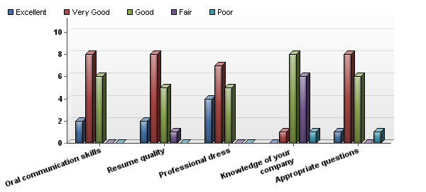
Employer perspectives
Based on your interactions with students at the career fair, please rate the following:

Slide 8
Employer perspectives
“To help determine which ones (resumes) to select for on-campus interviews, we cross-checked with ones that may have had good interaction with us at the Career Fair (to us, that showed a real genuine interest in the company, not just on trying to find a job).”
On how to improve…
“Ask us more relevant questions.”
“Know as much about the company as possible”

Slide 9
Before the fair
Questions for the Recruiters
Ideas
What do you want to know?
Have questions ready for the recruiters
What do you like about working for ________?
What additional skills or training would help me in this field?
What skills or work experience do you look for in a candidate?
What are the next steps?
Does your company have formal training programs, or do employees receive on-the-job training?
Can you describe your company’s culture?
Technical questions about company’s activities

Slide 10
Before the fair
Practice your handshake

Slide 11
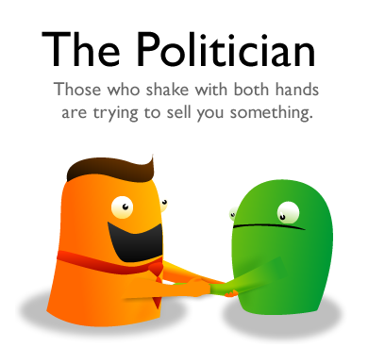
Before the fair
Source: http://theoatmeal.com/comics/handshakes

Slide 12
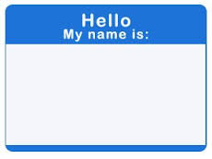
Before the fair
Practice your introduction
Start simple
Example:
Hi, my name is ______________. I’m a _____________ at the Jackson School studying _________. I’m currently looking for a __________ position for _______________.
Elevator pitch
Summarizes your skills, goals, experience, and your current career objective
Practice!

Slide 13
6 Pitches for the 21 Century
https://www.youtube.com/watch?v=XvxtC60V6kc

Slide 14
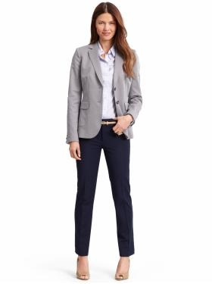
At the fair
Appearance
Business casual for women:
2 Pieces (no jacket required)
Flats, nice sandals, low heels
Top: Blouse, button-up, tailored shirt
Bottom: Dress pants, knee length skirt or dress, khakis

Slide 15
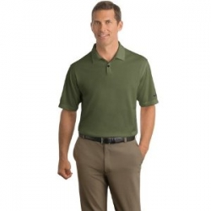
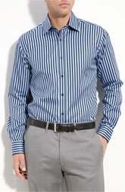
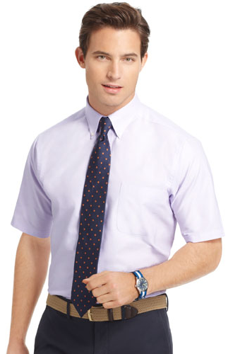
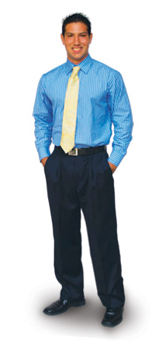
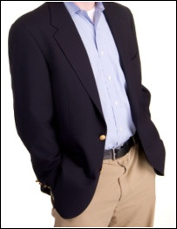
At the fair
Appearance
Business casual for men:
2 Pieces (no jacket required)
Top: Button-up shirt, collard polo
Sports jacket or blazer ok
Bottom: Dress pants, khakis with belt
Shoes: Formal or dressy

Slide 16
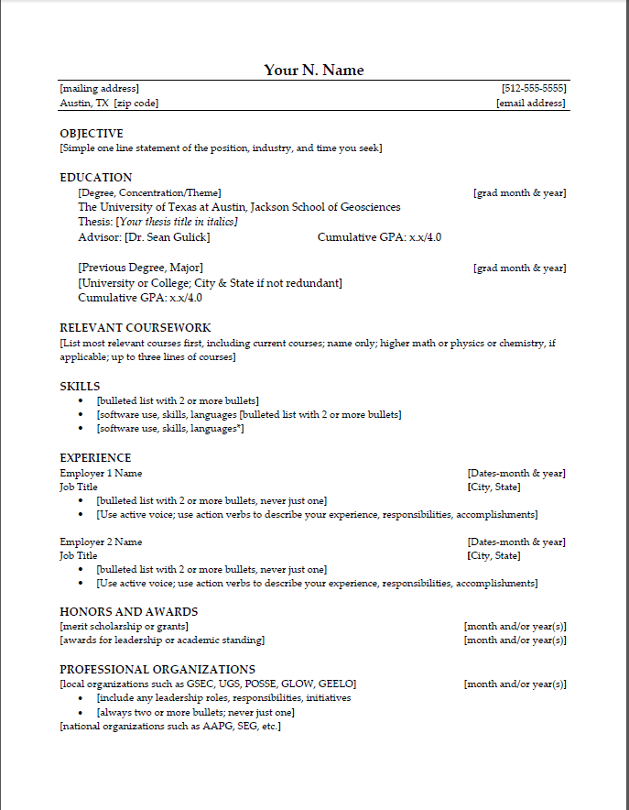
At the fair
What to Bring
Belongings
Backpack check-in
Padfolio check-out
Resumes

Slide 17
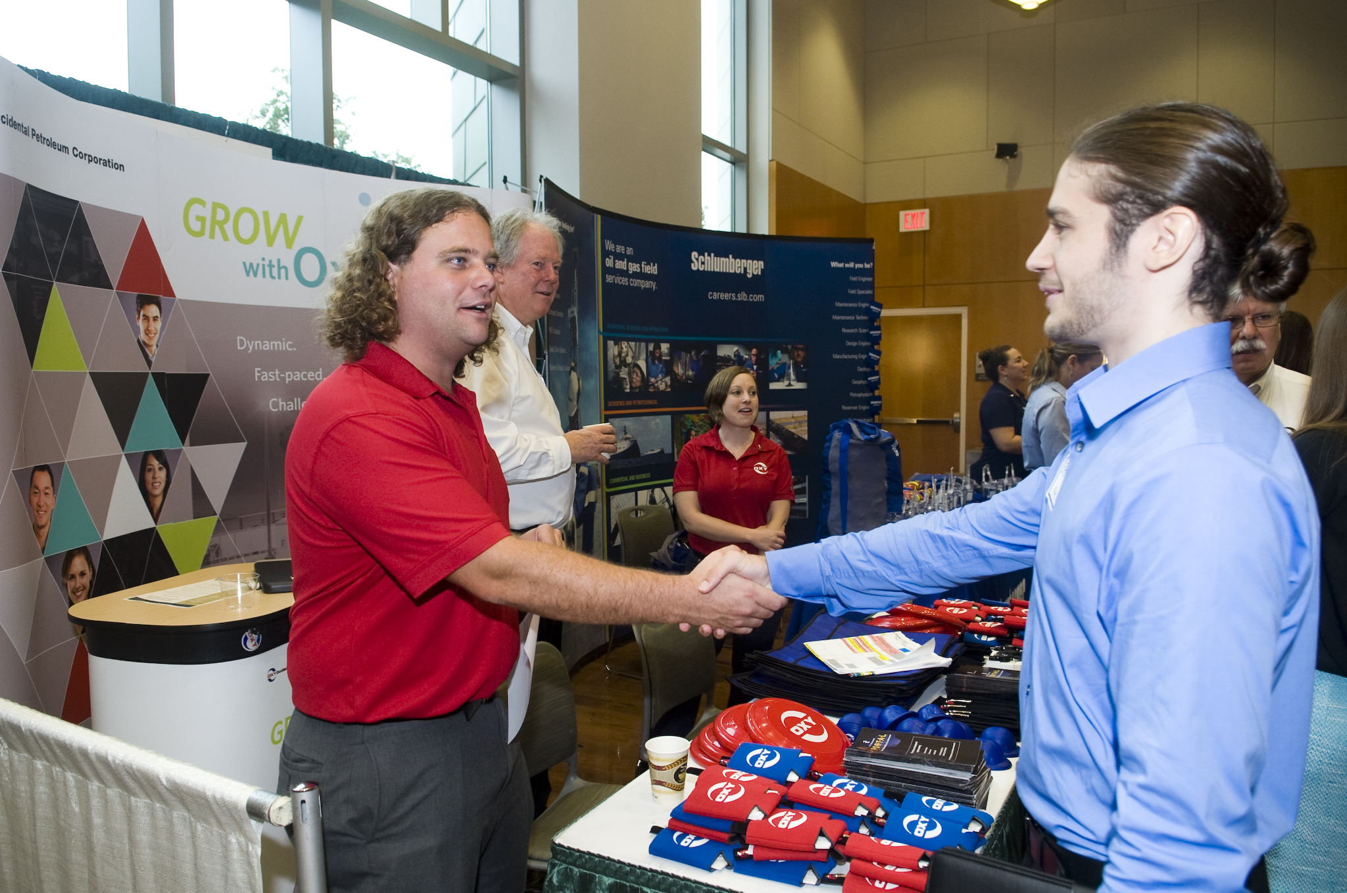
At the fair
Approach the Booth
Smile
Offer handshake
Introduce yourself
Ask questions

Slide 18
Share your resume
Be ready to provide a summary of your educations, skills and qualifications for the job or internship with the company.
Have several copies of your resume printed on resume paper ready to hand out to employers.

Slide 19
You might have to wait…

Slide 20
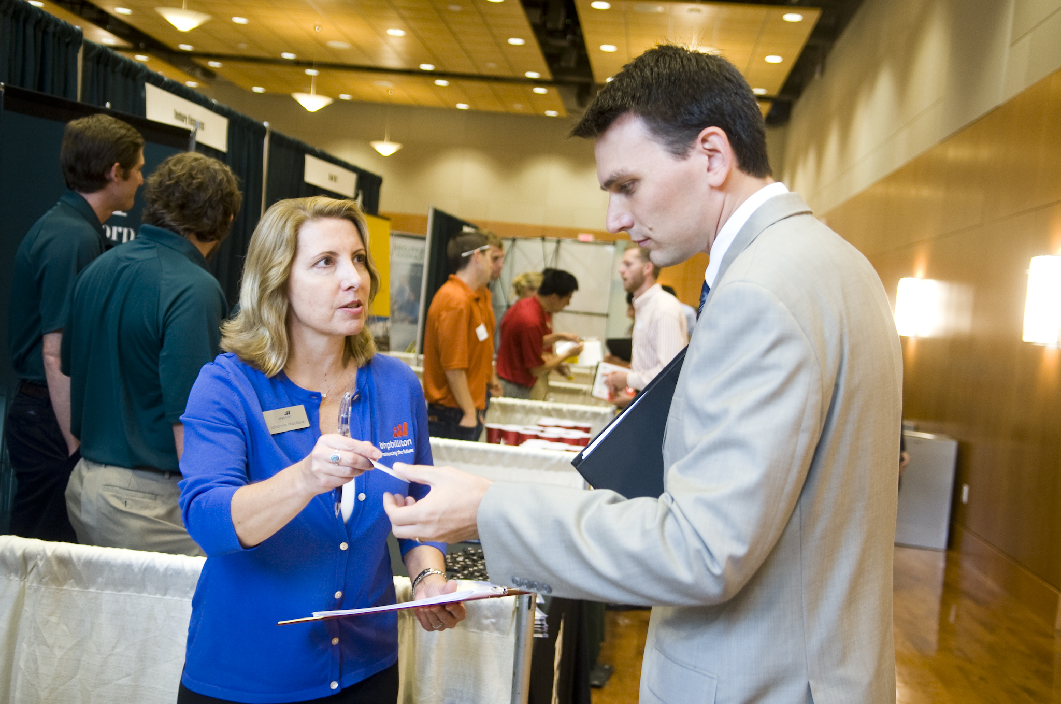
At the fair
Close the Conversation
Collect business cards
Ask about next steps
How to apply if no job on Career Connections

Slide 21
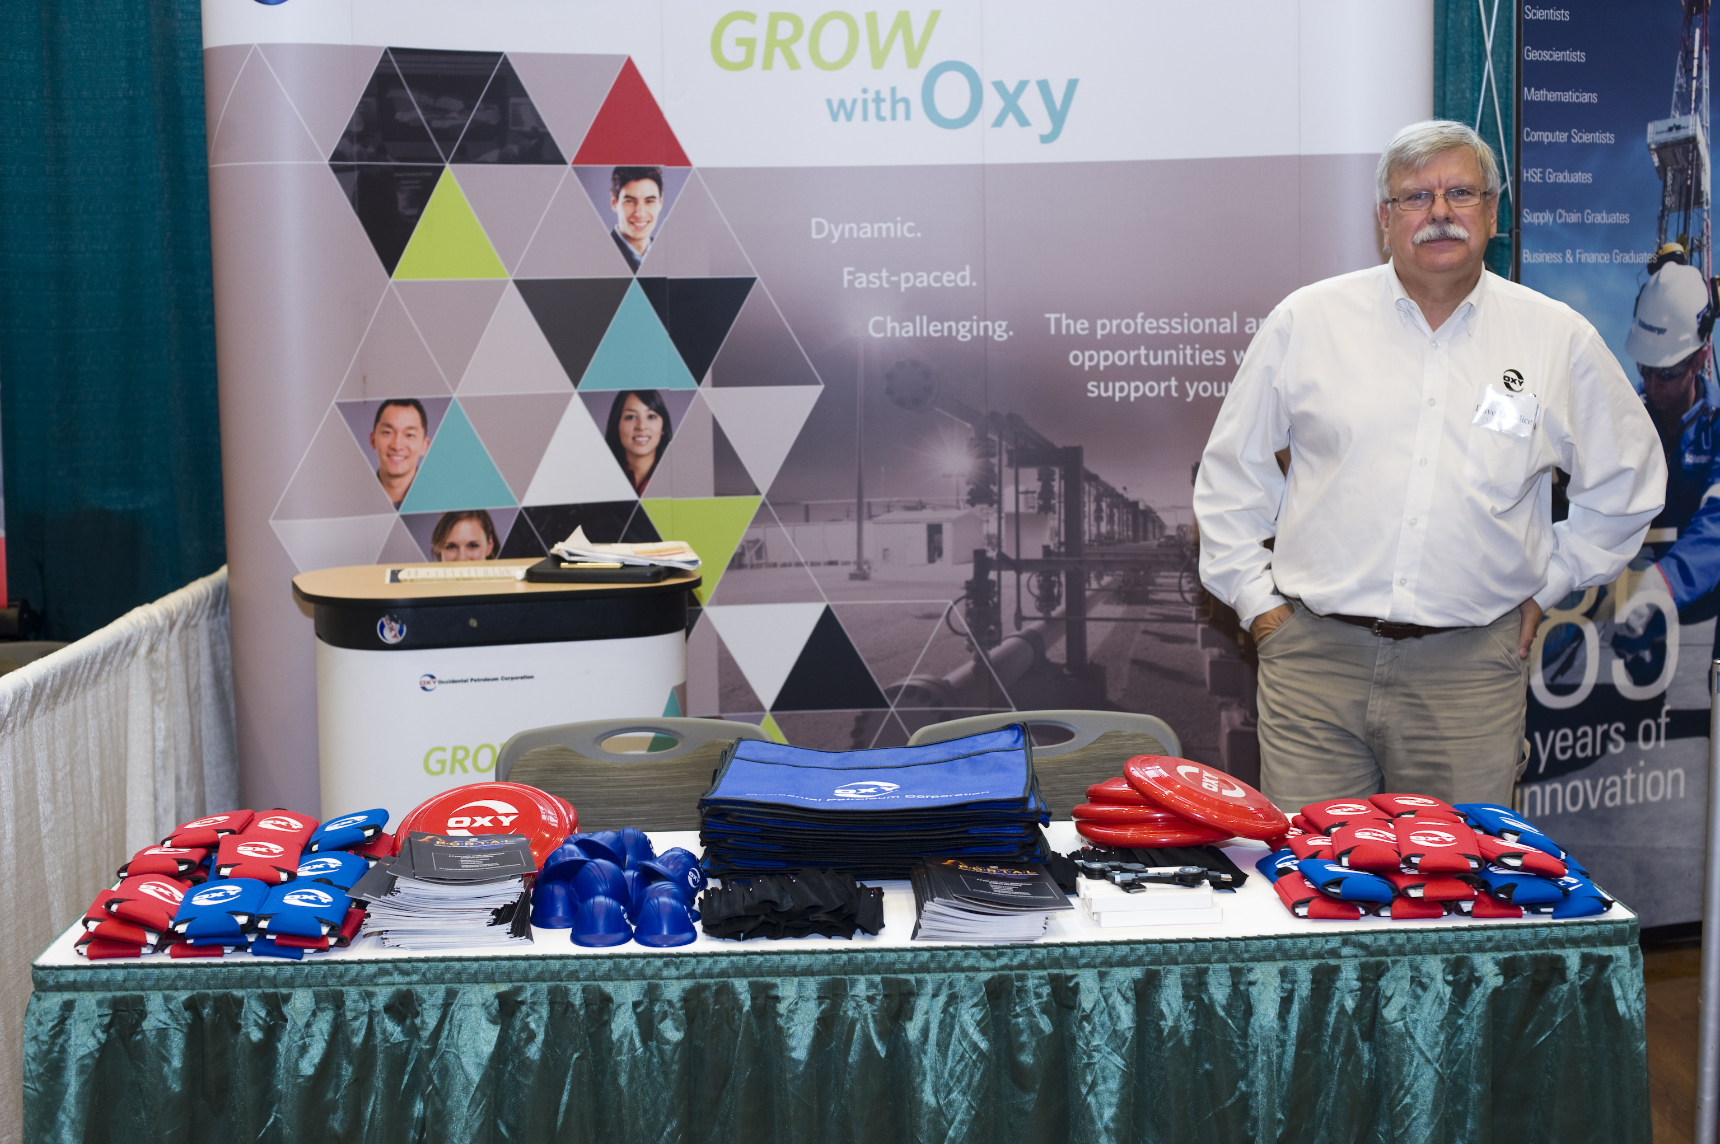
At the fair

Slide 22
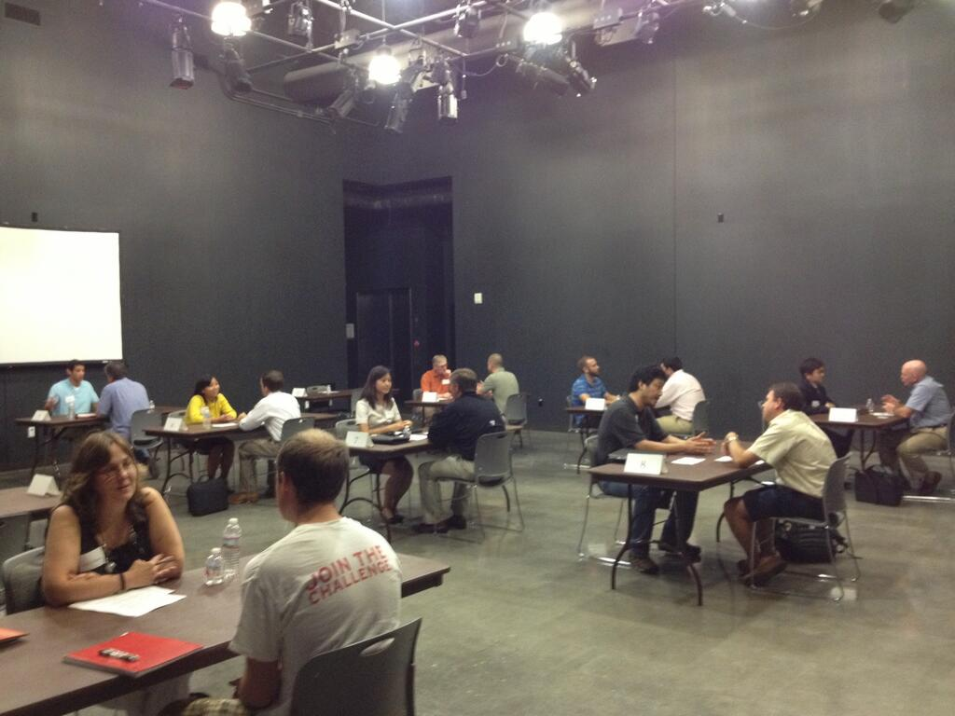
After the fair
Don’t forget to…
Send a thank you note
Prepare for interviews
Career Connections online mock interview. Record and critique!
Mock Interviews with BHP 9/12
Resources in Document Library

Slide 23
Additional resources on canvas!
RWS F2017
https://utexas.instructure.com/courses/1211021/pages/resources

Slide 24
Questions?
Jennifer Jordan Career Services Director
JGB 2.106A
512-232-0893
jjordan@jsg.utexas.edu

